Slide 1
A Search for Submillimeter Polarization by Rayleigh Scattering
By Andrew Srisuwananukorn

Slide 2
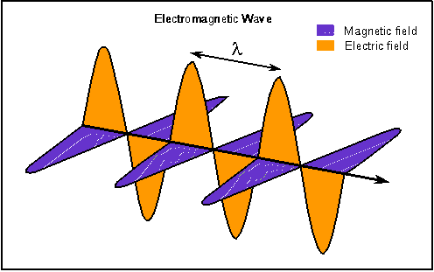
Linearly Polarized Light

Slide 3
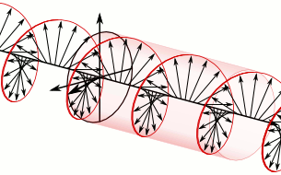
Circularly Polarized Light

Slide 4
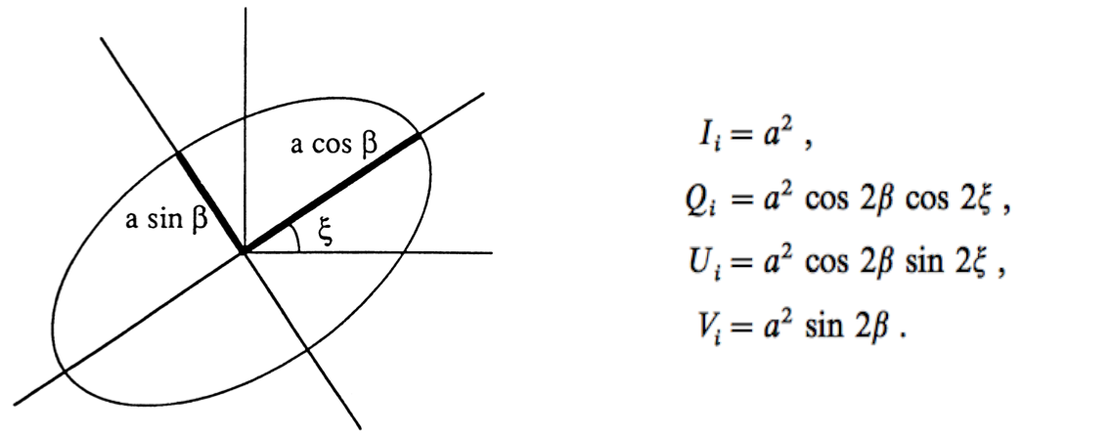
Stokes Parameters

Slide 5
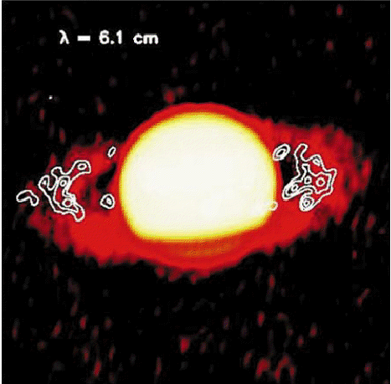
Inspiration: Van der Tak

Slide 6
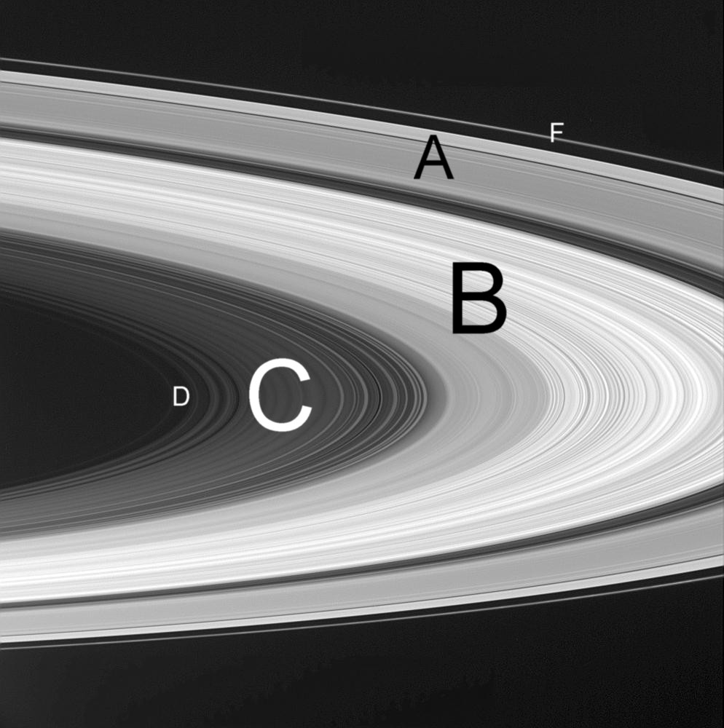
Saturn’s F ring

Slide 7
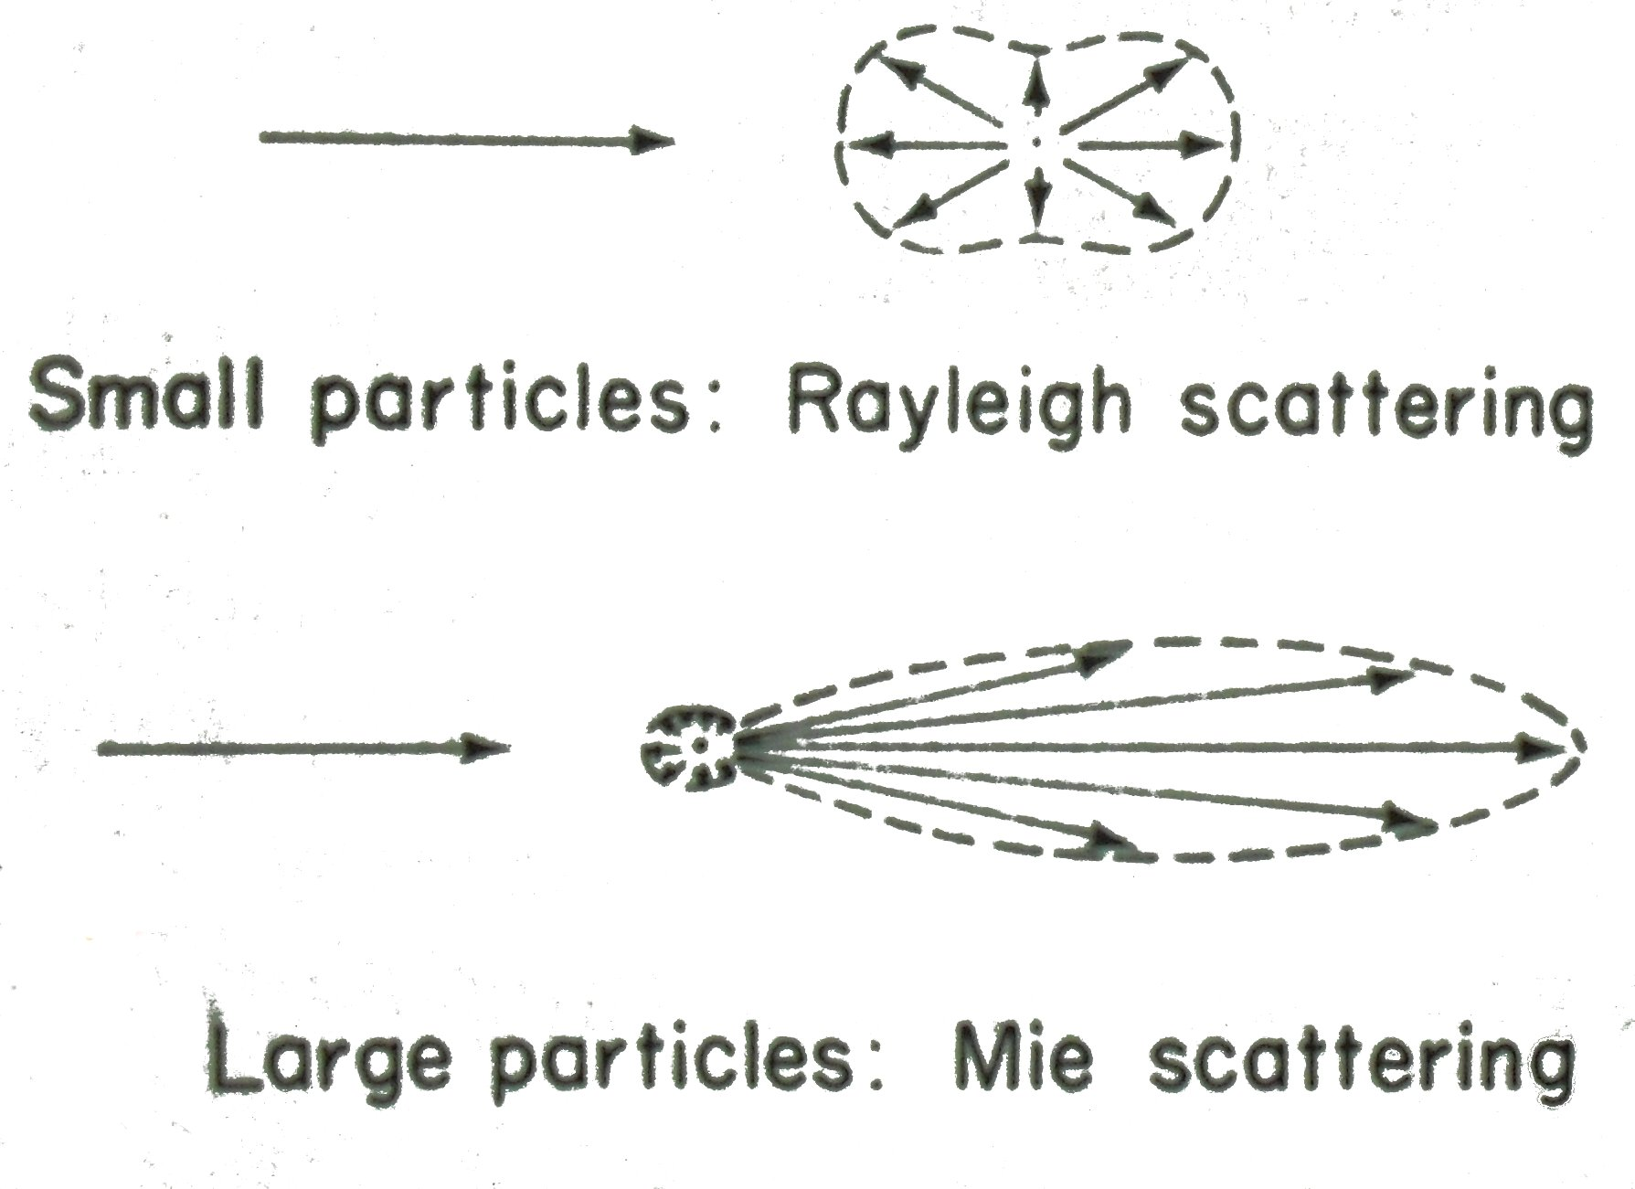
Light Scattering

Slide 8
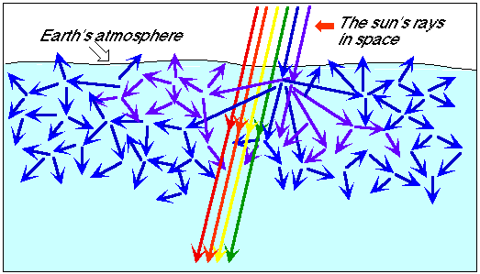
Blue Sky

Slide 9
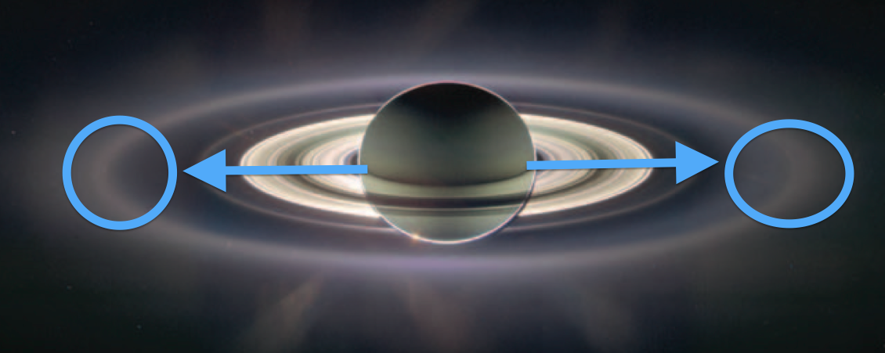
Saturn Scattered

Slide 10
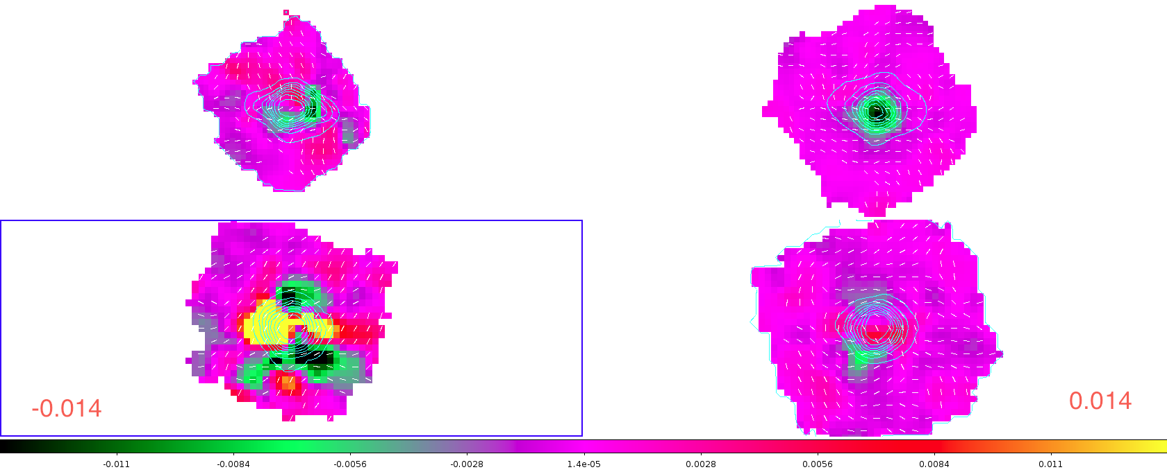
My Results: Q Maps

Slide 11
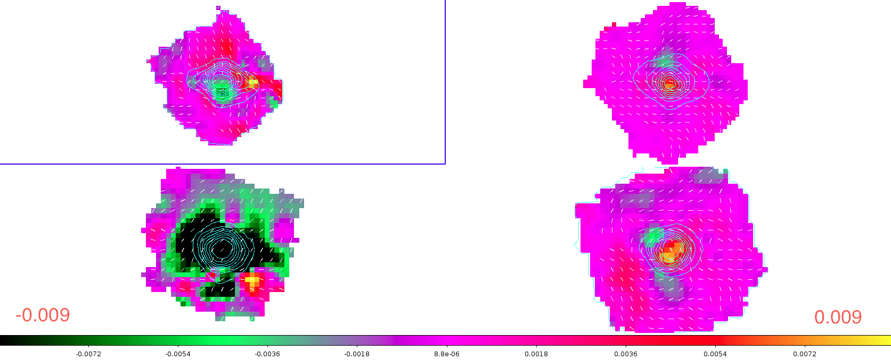
My Results: U Maps

Slide 12
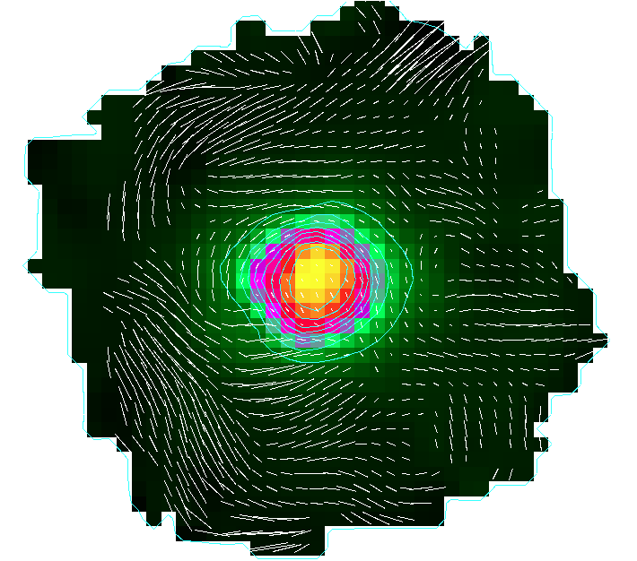
Polarization Vectors

Slide 13
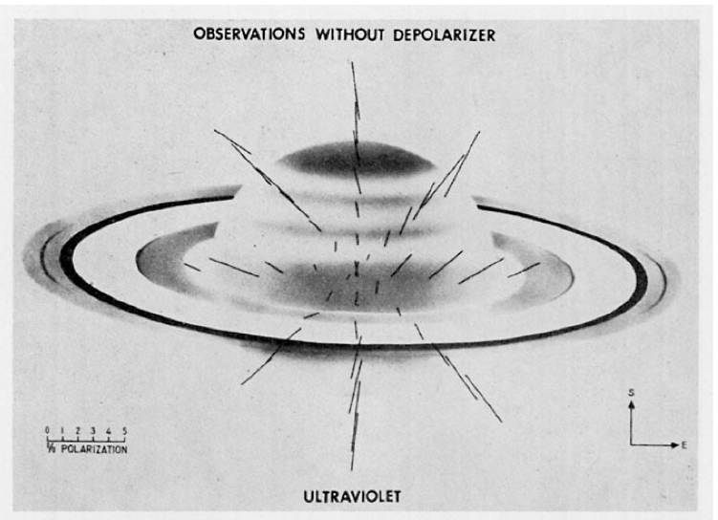
UV Polarization

