Slide 1
Blue Stragglers
Caroline Darin
Nico Salzetta
Advisors: Aaron Geller, Daryl Haggard
Notes:
Period-the amount of time it takes for the stars in a binary system to complete one orbit
Eccentricity-shape of the orbit

Slide 2
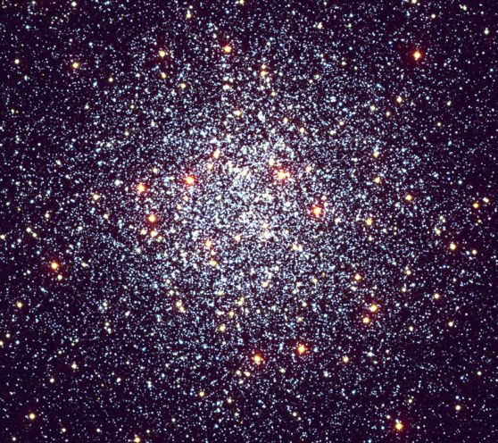
Star Clusters
All stars in a cluster are around the same age
Spherical distribution
Two types: globular and open clusters

Slide 3
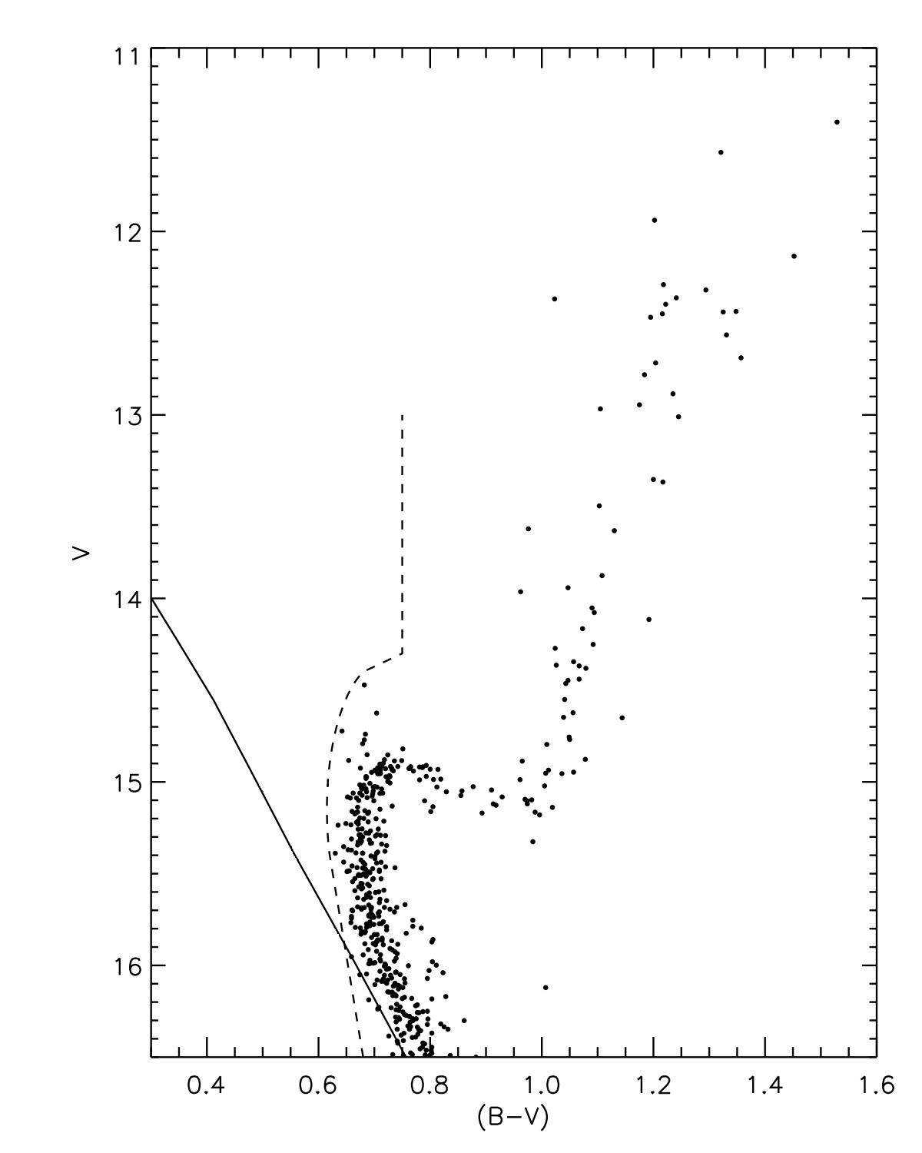
Star Clusters cont.
Stellar evolution based solely on initial mass
Stars in cluster graphed on Color-magnitude diagram, map out smooth trend of stellar evolution

Slide 4

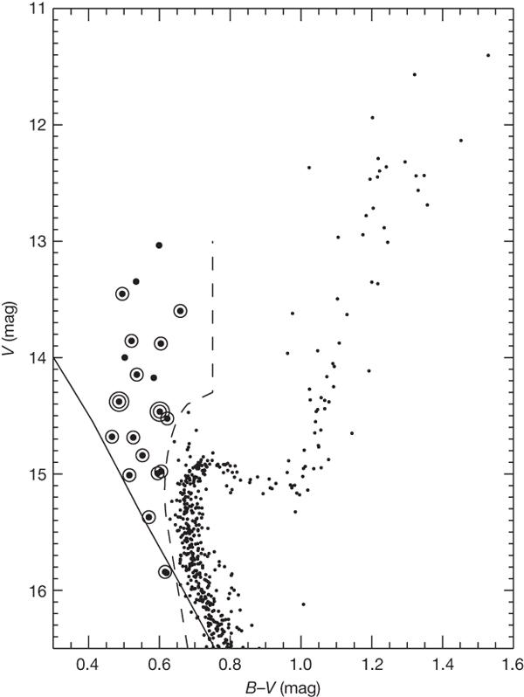
Blue Stragglers
Left of the dashed line
Brighter and bluer than other Main Sequence stars
Because of this, they appear younger - they 'straggle' behind other stars of similar mass
Are usually observed in long period binaries
Robert D. Mathieu & Aaron M. Geller Nature 462, 1032-1035(24 December 2009)
Notes:
-hr diagram for ngc 188
-explain axes
-MS, RGB, AGB
-point out blue stragglers, why don't they follow normal evolution?

Slide 5
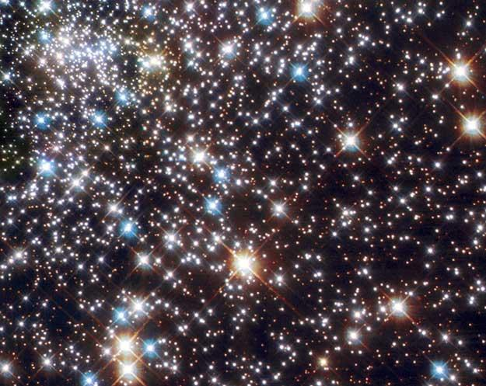
Blue Straggler Formation Theories
Since stellar evolution based on initial mass of star, irregular evolution is probably from a change in mass mid-evolution
Collisions
Mass transfer
Mergers in triple star systems

Slide 6
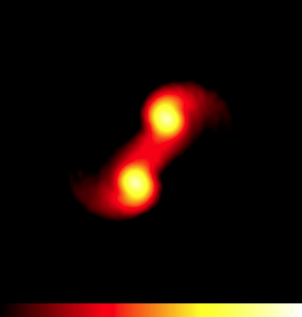
Collisions
Collision between two stars(during binary-binary encounter) in a dense cluster
Leaves binary with long period and high eccentricity
N-body simulations show that only some blue stragglers could come from collisions
Also cannot explain field blue stragglers because star collisions are extremely rare in the field
Notes:
The resulting star would be more massive and brighter than the rest of the stars in the cluster.

Slide 7
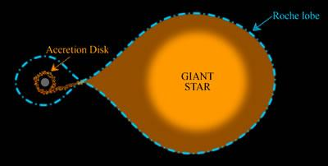
Mass Transfer
Wind Accretion-winds from giant accrete on main sequence companion, new mass makes MS star look bluer and brighter
Roche Lobe overflow-giant evolves to fill roche lobe and transfers mass to companion, making it look bluer and brighter
Mass Transfer tends to circularise orbits through tidal forces so we expect low eccentricities and longer periods
Blue stragglers should somewhat resemble other mass transfer stars such as CH, Barium and S-Type Stars

Slide 8
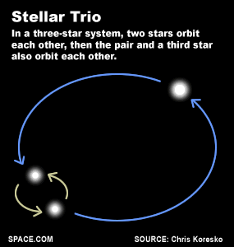
Mergers in Triple Star Systems
Merger in binary could produce blue straggler, but would be single star, not binary
Usually involve a very close inner binary and a wider tertiary that orbit the system's center of mass
Theory is that inner binary merges and forms blue straggler while tertiary star continues to orbit around center of mass
Predicts blue straggler binaries with long periods, range of eccentricity
Progenitor conditions for blue stragglers:
  .75 < Inner binary total mass < 3
  .05 < Outer star mass < 3
  Inner binary period < 10 days

Slide 9
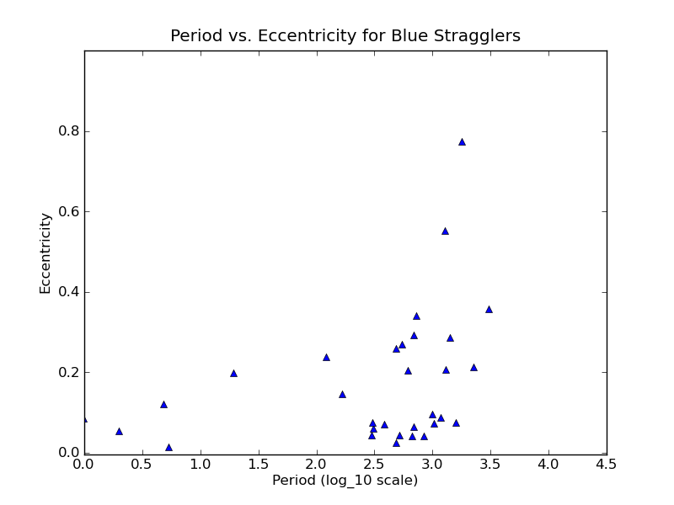
Blue Stragglers
Collected periods and eccentricities of blue straggler binaries, regular giant binaries, mass transfer binaries and triple systems(outer orbit)
Notes:
most theories predict particular eccentricities and periods for blue stragglers so looking at these variables for all blue stragglers can shed light on their origin

Slide 10
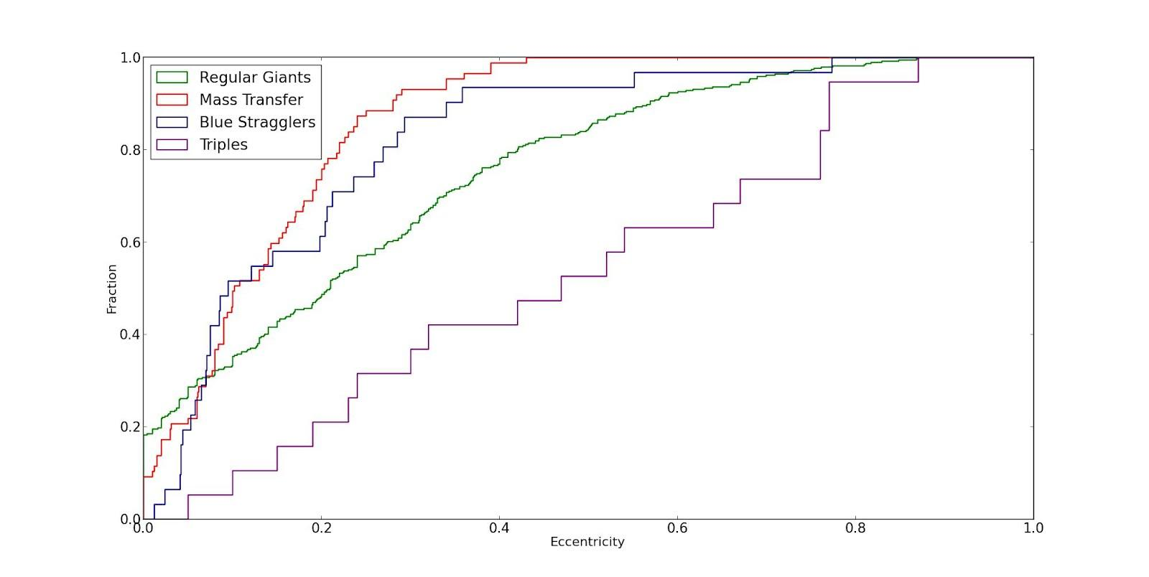
Cumulative Frequency of Eccentricities

Slide 11
Mass transfer and blue stragglers not statistically different using KS test
Triples and BS statistically different
We know BS are formed both ways however so...

Slide 12
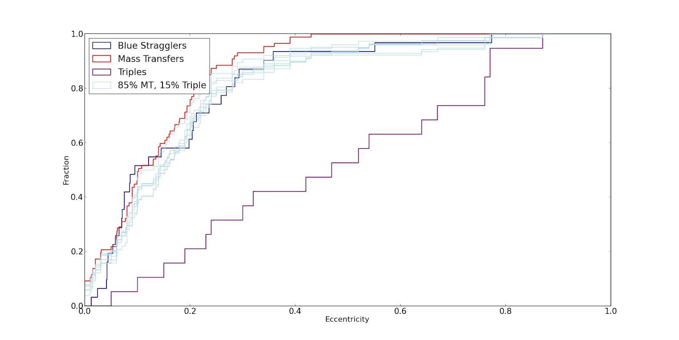
Hypothesis Graph

Slide 13
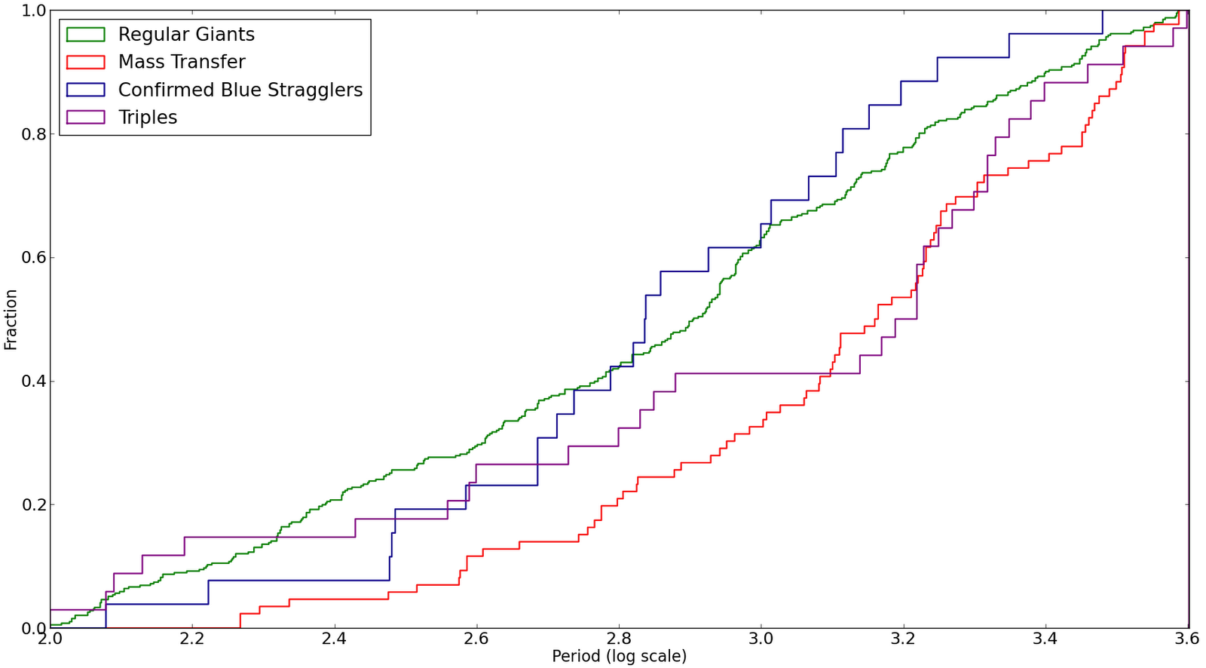
Cumulative Frequency of Periods

Slide 14
Period Interpretation
Triples don't fit for eccentricity, leaves mass transfer
The wind accretion mass transfer stars have longer periods than the blue stragglers
Leaves Roche Lobe overflow mass transfer
RLOF predicts shorter periods than wind accretion, so this makes sense because the blue stragglers have shorter periods than the wind accretion mass transfers

Slide 15
Future Work
Spend next few weeks running BSE code to simulate binary evolution, obtain resulting eccentricities and periods
Try to create eccentricity and period distribution of blue stragglers
Explore differences between mass transfer via wind accretion and RLOF

Slide 16
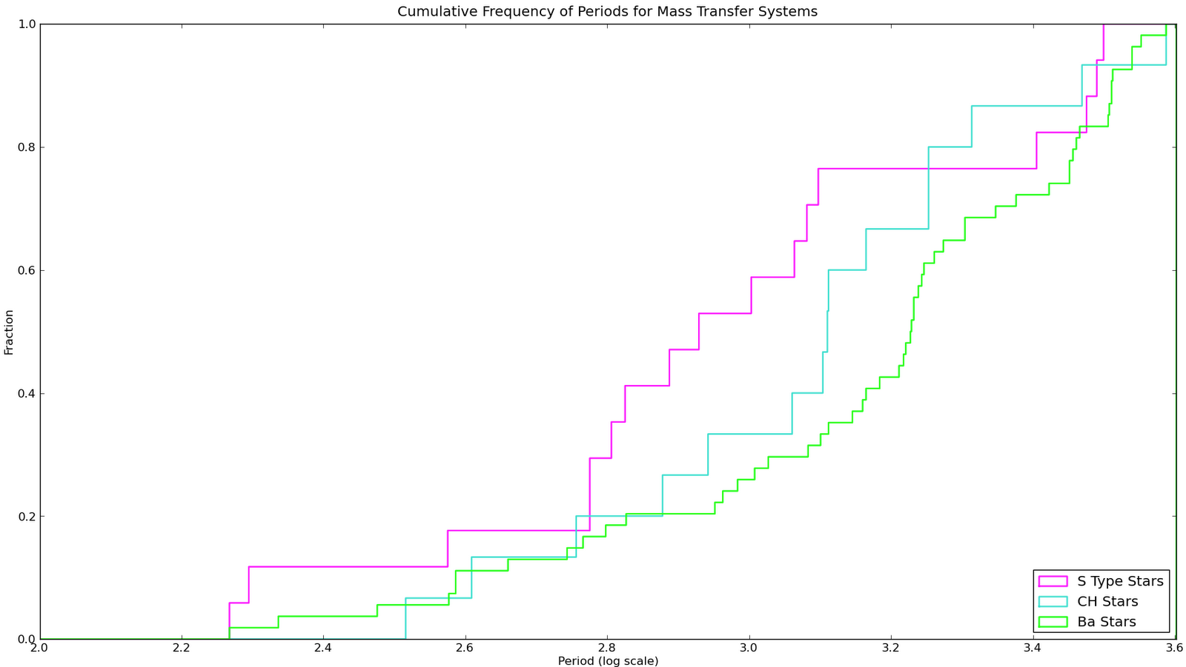
KS-Test
D-Value

Slide 17
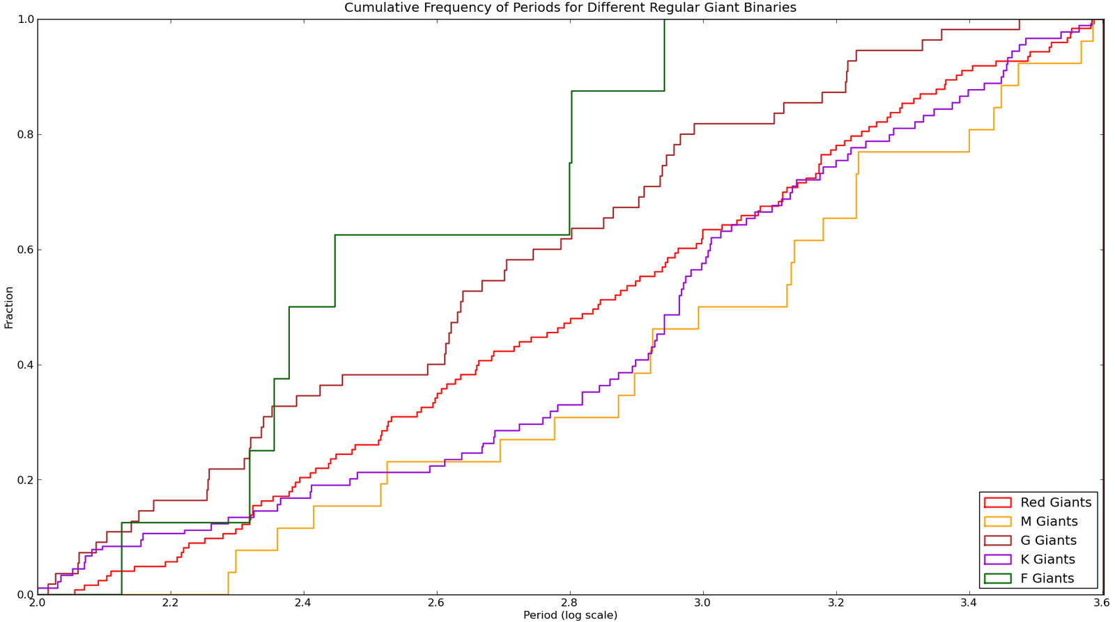
Cumulative Frequency of Period for Regular Giants

Slide 18
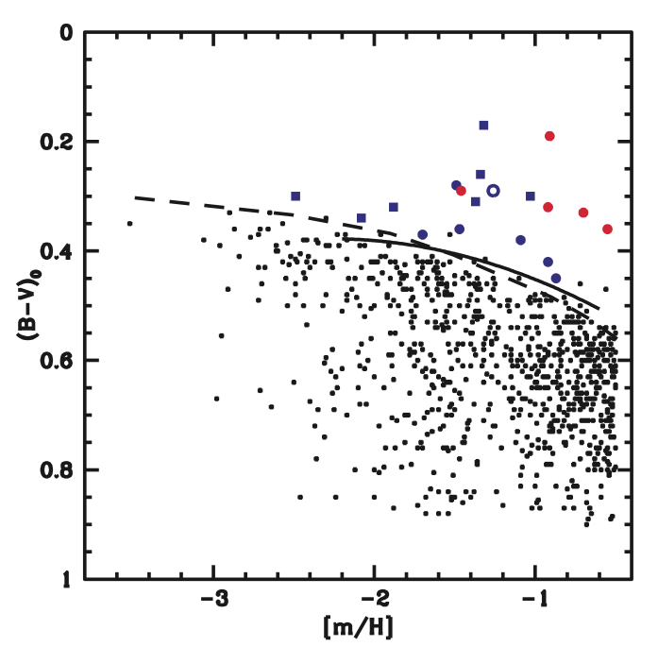
Identifying Field Blue Stragglers
dots are metal poor field MS stars
blue and red points are either confirmed or candidate blue stagglers
lines are fits for color as a function of metallicity for main sequence turnoff stars in globular clusters

