Slide 1
Magnetostrictive Materials for
X-Ray Optics
Bridget Bellavia and Julia Savoie
August 17, 2012
Summer Research Program

Slide 2
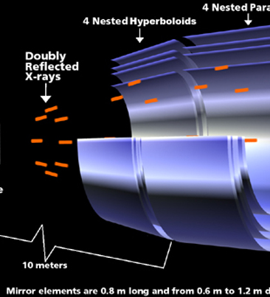
X-Ray Optics
Current technology: Chandra Mission
  Observes x-rays from high energy regions of the universe (example: remnants of stars)
Problems with current x-ray optics technology:
  Expensive
  Thick
  Heavy
Source: Chandra Mission Website
http://chandra.harvard.edu

Slide 3
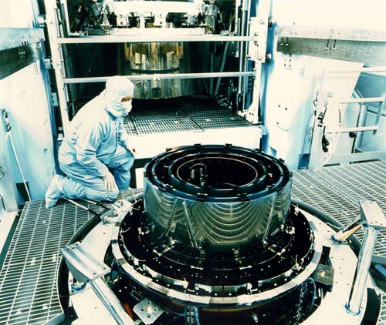
Our Idea
Start with electroformed Ni or Ni-Co
Coat magnetostrictive material to metal
Use magnetic field to locally remove built in stress
Source: Chandra Mission Website http://chandra.harvard.edu

Slide 4
Why Magnetostrictive Materials?
Magnetostrictive materials change shape or dimension in response to a magnetic field
Magnetic domains in the material are aligned by the externally applied magnetic field
This property can be used to fine-tune the mirror to a desired shape

Slide 5
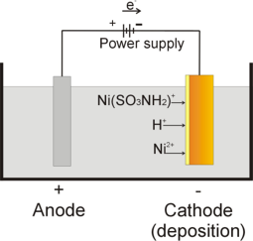
Mirror: Electroforming
A metal forming process used to make Ni or Ni-Co mirrors that will be coated with magnetostrictive material
Process: metal ions in a electric field plate a mandrel
Sometimes the sample is annealed before coating to decrease the inherent stress
Source: University of Twente. http://www.utwente.nl/ewi/tst/research/microfabrication/mmflowcontrollers/index.html

Slide 6
What defines a thin film?
A thin film is defined as 1/10 or less of the thickness of the substrate

Slide 7
Sputtering Process
Pull a vacuum to prevent impurities in the film
Fill chamber with Argon gas
By adding a high voltage, the argon will arc to plasma state.

Slide 8
Sputtering Process
The argon ion (Ar⁺) will shoot toward the cathode and sputter the target material
The target atom is knocked out by Ar⁺ ion

Slide 9
Sputtering Process
The collision force is so great that it will accelerate the target atom at high speed
The accelerating target atom can hit and attach to the substrate surface deeply to form a good film density

Slide 10
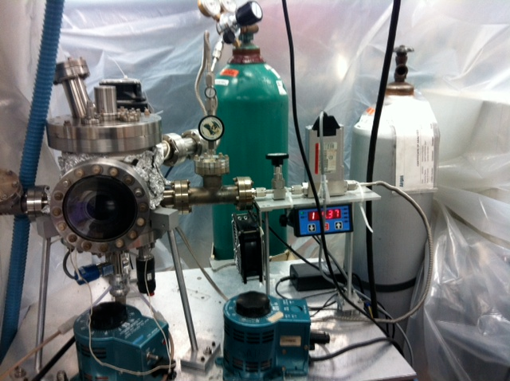
Our Chamber

Slide 11
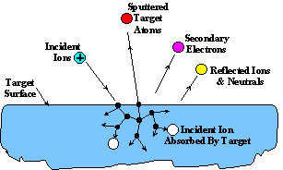
Summary of Sputtering Process
Argon ions (Ar⁺) from a plasma are accelerated towards negatively-biased target
Momentum transfer
  “Atomic billiard”
Atoms are ejected from target and deposited on substrate, forming a thin film

Slide 12
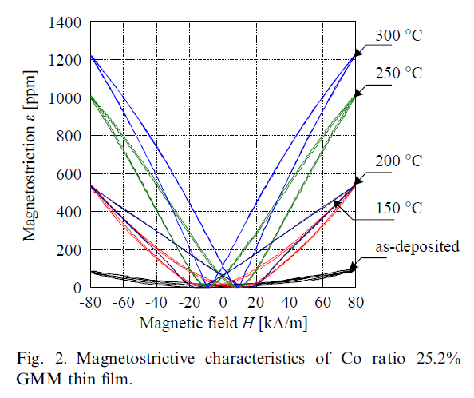
Post-Coating Annealing
Enhance magnetostrictive properties of coating
Decrease stress of material

Slide 13
Characterizing MSM film: Deflection

Slide 14
Measuring Deflection: Zygo

Slide 15
Results
Left: coated with KelvinAll Right: uncoated
Curvature scale is 3 times greater for coated sample.

Slide 16
Present Work
If we put a magnetostrictive film on Ni that is only microns thick, the film will stiffen the Ni.
This means that we get some change in shape before we put in the magnetic field.
Once we anneal it to lower the stress, it can change shape but it never reverts back to its original shape.
We believe that this could mean that the film retains a magnetic field.

Slide 17
Present Work
At this moment, we realize that a vertical component of the magnetic field could be mimicking the results we need.
To resolve this, we either will use a shield or find a new way to measure the curvature.

Slide 18
Present Work
Optimizing coating conditions
  High stress coatings completely warped samples, making results unreliable
  By testing the curvature of samples before and after coating, we found sputtering parameters that would induce the least amount of stress in samples

Slide 19
Future Steps
Investigate other target materials: NiMnGa
Deposit thicker film on thinner substrate
Use larger, cylindrical substrates
Learning about writing and retaining magnetic fields
Learning how to control the figure shaping in detail, especially making the surface curve in or out

Slide 20
Acknowledgements
Professor Ulmer
Professor Graham
Professor Vaynman
Xiaoli Wang
Jerry Carsello and Carla Shute

Slide 21
References
http://hyperphysics.phy-astr.gsu.edu/hbase/phyopt/totint.html
http://www.etafilm.com.tw/PVD_Sputtering_Deposition.html

