Slide 1
The latest Rossiter-McLaughlin measurements of WASP systems
David Brown
(University of St Andrews)
Et al
Extreme Solar Systems 2; 13/9/2011
Notes:
Presenting the most recent measurements of the RM effect for WASP systems. Based mostly on work in Brown et al (submitted). Will also be looking at how these affect previously discussed trends in the ensemble of RM results, and therefore how they impact misalignment theories.

Slide 2
Introduction
18 Rossiter-McLaughlin measurements of WASP systems to date.
Ongoing programs:
HARPS for Southern targets
SOPHIE for Northern targets
Present 3 new WASP systems.
Combined analysis of full photometric and spectroscopic datasets.
Extreme Solar Systems 2; 13/9/2011
Notes:
There are 18 published Measurements of Rossiter-McLaughlin, to which we add 3 new measurements arising from analysis of the complete photometric and spectroscopic data sets of the systems in question. These new results are part of an ongoing program to measure the RM effect of planets discovered by the WASP survey, which uses HARPS in the Southern hemisphere. SOPHIE??? (Check with AT).

Slide 3
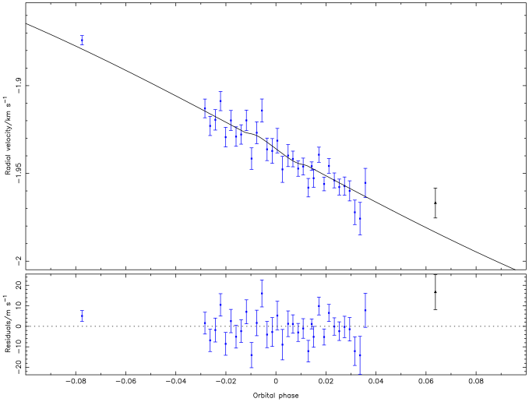
WASP-16
CORALIE
HARPS
Extreme Solar Systems 2; 13/9/2011
Notes:
At the IAU symposium in Torino last September, AT showed the first set of data that we obtained for WASP-16. This is it, showing very little in the way of RV anomaly. The run was cloud affected, so not particularly useful. It was very difficult to place limits on the value of lambda using this data.

Slide 4
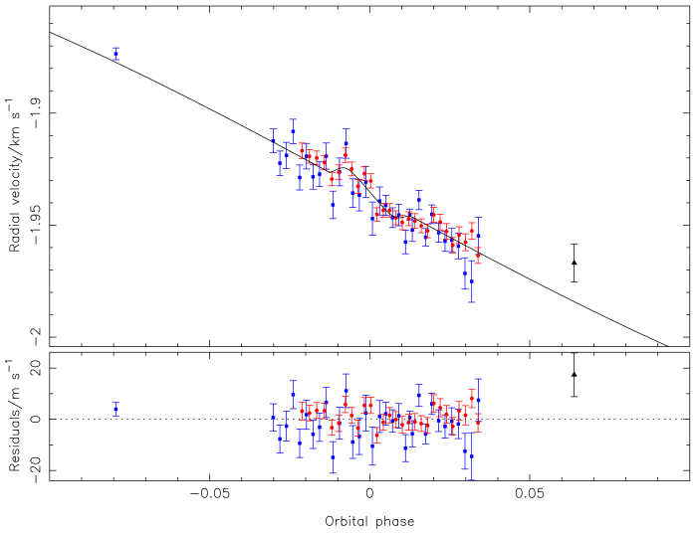
WASP-16
Brown et al (submitted)
CORALIE
HARPS
HARPS
Extreme Solar Systems 2; 13/9/2011
Notes:
Since then we’ve observed a further transit using HARPS, here in red, which showed a slightly better signal. Combining the two data sets has allowed us to to place some limits on the projected angle.

Slide 5
WASP-16
Circular orbit adopted.
No long-term trend detected.
T_{eff} = 5700 ± 150 K
λ = -4.6^{o +8.7}_{-10.0}
vsinI = 1.5 ± 0.5 km s⁻¹
Extreme Solar Systems 2; 13/9/2011
Notes:
Find the system to be well aligned, with circular orbit. No trend in RV was detected. Albrecht et al recently showed that in systems with low amplitude & low SNR, results of RM analysis tend to be biased towards 0 or 180 degrees. This results seems to fall into this trap. However it is possible to analyse the RM effect in other ways, such as doppler tomography. Miller et al (in progress) are analysing WASP-16 using this method (see poster xxx) and indications are that it is indeed aligned.

Slide 6
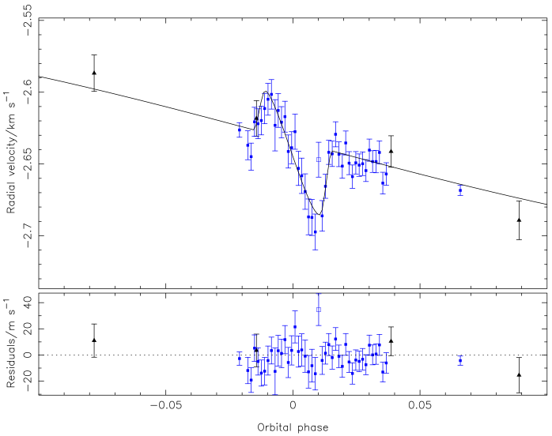
WASP-25
Brown et al (submitted)
CORALIE
HARPS
Extreme Solar Systems 2; 13/9/2011
Notes:
Second system is WASP-25 Much stronger signal for this system. Single transit observation using HARPS. Open square point was ommitted from analysis, as found to lie approx. 3sigma from model. Not sure what has produced this point. Some structure seems to be present in the residuals; this was originally more pronounced, but removing datum helped. Asymmetric form of anomaly suggest misaligned system? Might be a systematic effect.

Slide 7
WASP-25
Circular orbit adopted.
No long-term trend detected.
T_{eff} = 5750 ± 100 K
λ = 22.9^{o +8.9}_{-7.1}
vsinI = 3.2 ± 0.4 km s⁻¹
Extreme Solar Systems 2; 13/9/2011
Notes:
Again, we found a circular orbit and no RV trend. Moderately misaligned, although sky-projected angle is less than 3sigma from 0 degrees and system is aligned according to existing misalignment criteria. Possible that asymmetry arises from some form of systematic effect (biased starspot placement for example?)

Slide 8
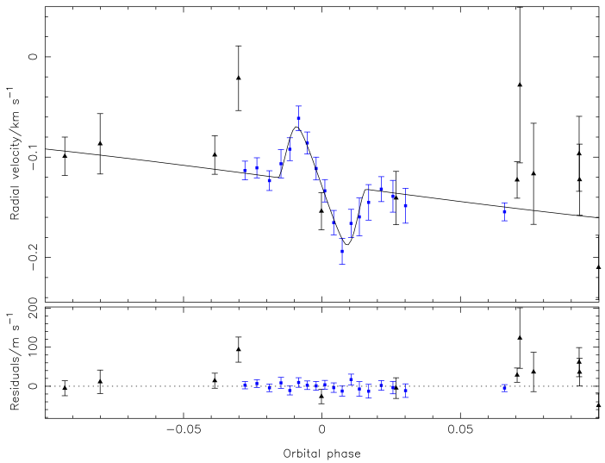
WASP-31
Brown et al (submitted)
CORALIE
HARPS
Extreme Solar Systems 2; 13/9/2011
Notes:
Finally, WASP-31. Again, a single HARPS transit observation. Nicely symmetric anomaly, very low residuals.

Slide 9
WASP-31
Circular orbit adopted.
No long-term trend detected.
T_{eff} = 6300 ± 100 K
λ = 1.6º ± 3.0
vsinI = 9.5 ± 1.1 km s⁻¹
Extreme Solar Systems 2; 13/9/2011
Notes:
As for the other two, we find a circular orbit and no RV trend. Well aligned, with small error on the angle thanks to the well defined (high S/N?) anomaly.

Slide 10
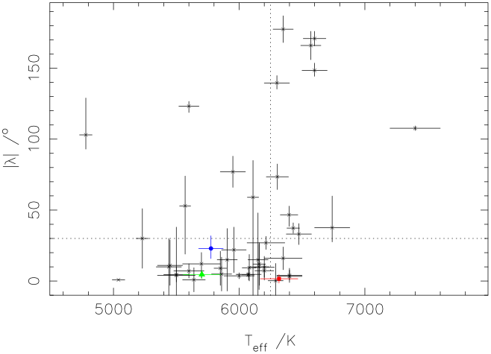
Integrating into the ensemble
Brown et al (submitted)
WASP-16
WASP-25
WASP-31
Extreme Solar Systems 2; 13/9/2011
Notes:
How do these fit into the existing trends. Here we add them to the lambda-Teff diagram that is commonly used, first presented by Winn et al 2010. Here you can see WASP-16 in green, -25 in blue, -31 in red. The new systems fit into areas of the diagram where they have little impact on previously discovered trends. WASP-31 is ‘cool’, and well –aligned. WASP-31, though ‘hot’ and aligned, falls in a region of the diagram where there are similar systems already. WASP-25 is a possible outlier, being ‘cool but mildly misaligned, but again there are other systems that fall in similar locations.

Slide 11
Integrating into the ensemble
Brown et al (submitted)
WASP-16
WASP-25
WASP-31
Extreme Solar Systems 2; 13/9/2011
Notes:
We are still missing systems in this region, particular at the hotter end.

Slide 12
Integrating into the ensemble
Brown et al (submitted)
WASP-16
WASP-25
WASP-31
See poster by Grant Miller (26.02)
Extreme Solar Systems 2; 13/9/2011
Notes:
We are still missing systems in this region, particular at the hotter end.

Slide 13
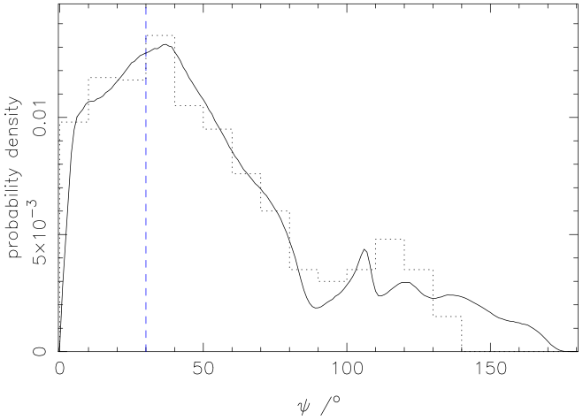
Integrating into the ensemble
Brown et al (submitted)
Extreme Solar Systems 2; 13/9/2011
Notes:
Triaud et al (2010) presented a total probability density distribution for the true misalignment angle. We have updated this, taking into account systems published since that paper as well as the results we have presented today. This still shows good agreement with the theoretical distribution of Fabrycky & Tremaine (2007), possibly even improved agreement, supporting their model of Kozai-oscillations and tidal friction producing the observed population. However, this assumes an isotropic and unimodal distribution in I – there is some evidence that this is not true.

Slide 14
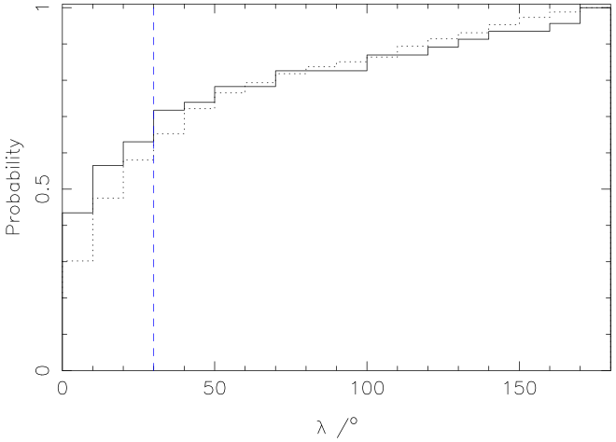
Integrating into the ensemble
Brown et al (submitted)
Extreme Solar Systems 2; 13/9/2011
Notes:
We therefore also consider the probability distribution in lambda, with the theoretical distribution transformed from psi assuming i=90. Agreement between theory and observations has improved since first presented in Triaud et al (2010, particularly at higher angles, but the theory is still underpredicting the number of systems at low projected obliquities. So while it appears that the Kozai + friction model is certainly playing a part, some other mechanism may be acting as well.

Slide 15
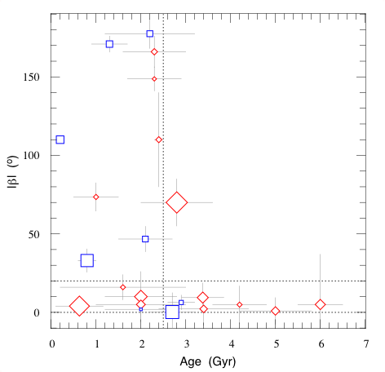
A new perspective?
Triaud (submitted)
Extreme Solar Systems 2; 13/9/2011
Notes:
Finally, we want to present a new perspective on the ongoing debate. This is based on work in Triaud (accepted), which Amaury is unfortunately not able to present here. Plotting lambda as a function of age for systems with Mstar >1.2 Msun (Blue squares are >1.3Msun). There seems to be a correlation, with no stars older than 2.5 Gyr showing large project obliquities. However the number of stars with hot Jupiters, both transiting and non-transiting, above and below this line is similar. This indicates that the aligned population is likely to have developed from a previously misaligned population that has undergone some realignment process, but that has survived the associated orbital decay. Going back to the Fabrycky and Tremaine model, Kozai oscillations produce the initial misaligned population, then tidal friction is realigning, but not causing infall. This suggests that the realignment timescale is shorter than the infall timescale. The trend seems to hold true for systems with masses around solar as well, but further work needs to be done to analyse this.

Slide 16
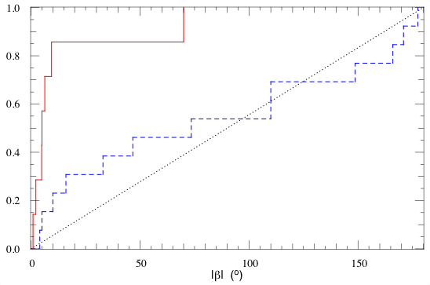
A new perspective?
Triaud (submitted)
Extreme Solar Systems 2; 13/9/2011
Notes:
Looking at the same data in a different way. Dashed line is age<2.5Gyr. Solid line is age >2.5 Gyr. Dotted line denotes uniform distribution. Young population 22% chance of uniform distribution from Kolmogorov-Smirnov test. For younger systems, rms=66, median=60. For older, rms=22 & median=5. K-S test gives 1.2% chance distributions on either side ofg 2.5Gyr are the same.

