Slide 1
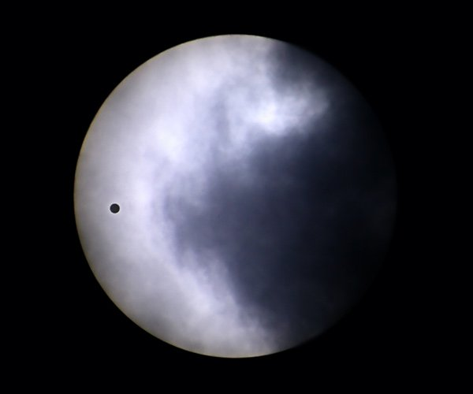
Detection of Hα Absorption in
Exoplanetary Exospheres
Seth Redfield
Wesleyan University
Adam Jensen (Wes)
Mike Endl (UT)
Bill Cochran (UT)
Lars Koesterke (UT)
Travis Barman (Lowell)

Slide 2
Outline
Comparative Exoplanet Atmosphere Survey
  Transmission spectra for 4+ bright transiting exoplanetary systems
  Substantial optical coverage (4000-9000 Å) at high resolution (R ~ 60,000)
Lower Atmospheres (Jensen et al. 2011)
  Survey of two strongest transmission spectrum features: NaI and KI
  Pilot program with HD189733b led to first ground-based detection of exoplanetary atmosphere (Redfield et al. 2008; Huitson et al. 2011)
  Survey results in low significance detections of NaI for HD209458b and HD149026b
  No significant detections of KI are made for any of our targets
Upper Atmospheres (Jensen et al., in prep)
  Search for Hα absorption to complement Lyα detections (Vidal-Madjar et al. 2003; Lecavelier des Etangs et al. 2010), Balmer jump detection (Ballester et al. 2007) and other searches for Hα (Winn et al. 2004)
  See significant absorption in transmission spectrum for HD189733b due to absorption from the upper atmosphere of the planet
  HD209458b has a significant feature perhaps due to chromospheric Hα variability

Slide 3
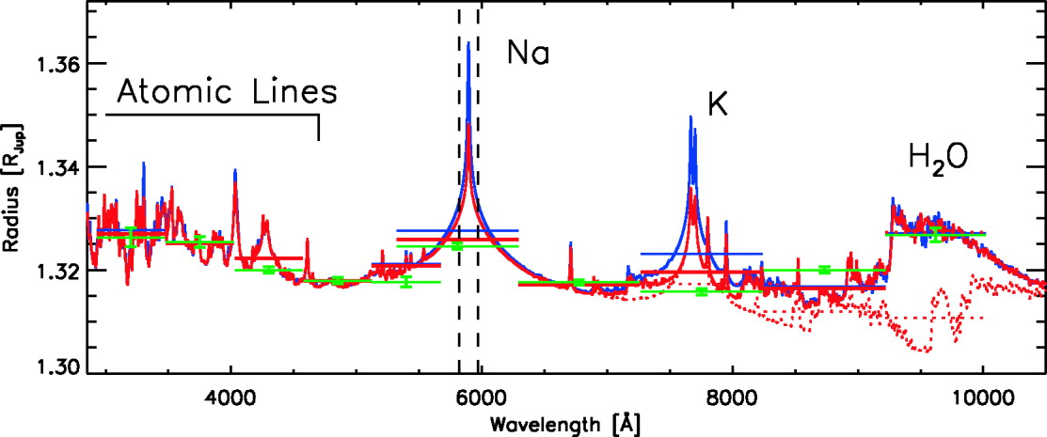
Transmission Model
(Barman 2007)
(Ca I)
(Li I)
(Rb I)
(Cs I)
Early models (Seager & Sasselov 2000, Brown 2001, Hubbard et al. 2001)
Most gases in molecular form except He and alkali metals
Strongest features are narrow lines of NaI and KI
Volatile elements (e.g., Mg, Ca, Ti) have condensed into grains

Slide 4
Observations
HD189733
9.2m Hobby-Eberly Telescope (HET)
High Resolution Spectrograph (R ~ 60,000)
Observations taken between 2006 and 2010
Queue-based scheduling allowed for multiple transits and random collection of out-of-transit observations
Substantial optical coverage (4000-9000 Å)
6-11 transits observed along with 2.5-5x number of out-of-transit visits
HD147506
HD209458
HD149026

Slide 5
Na and K Results
New reduction and analysis pipeline reproduce HD189733b NaI detection (Redfield et al. 2008; Huitson et al. 2011)
Confirm HD209458b NaI detection (Charbonneau et al. 2002; Snellen et al. 2008)
Low significance absorption for HD149026b, but seen in both NaI lines
No KI absorption detected for any of our targets (see Sing et al. 2010; Colón et al. 2010)
(Jensen et al. 2011)

Slide 6
Sample Hα Spectra
(Jensen et al. in prep)

Slide 7
Hα Transmission Spectra
(Jensen et al. in prep)
No signal in HD147506b or HD149026b
Strong absorption in HD189733b correlated with transit (1.55% across absorption feature ±25 km/s or ~1.1 Å)
Symmetric feature seen in HD209458b correlated with phases near transit (but not seen in previous observations of HD209458b by Winn et al. 2004)

Slide 8
Monte-Carlo Analysis
(Jensen et al. in prep)
Chromospheric variability detected for HD189733 (Fares et al. 2010; Lecavieler des Etangs et al. 2010); in-transit absorption significant at 4.6σ

Slide 9
Conclusions
Optical survey of 4 bright transiting exoplanets
Cover two strongest lines in transmission spectrum, NaI and KI, and Hα
Reproduce HD189733b and HD209458b detections and see low significance absorption for HD149026b (with absorption in both lines of the NaI doublet)
No detection of KI absorption for any of our targets
First detection of Hα absorption from an exoplanetary atmosphere in HD189733b. Chromospheric Hα variability is also detected.
Excitation temperature is T_{exc} ~ 27000 K (assuming unsaturated absorption and Lyα and Hα populations are coincident)
See symmetric feature at Hα in HD209458b transmission spectrum, correlated with transit. Possibly reduction artifact, but not seen in other 3 systems, nor a simple wavelength offset. Could stellar activity be responsible for a variable offset of the wings and core of the Hα lines?
Motivates resolved Lyα observations for HD189733, and further investigation into Hα, ideally tied to other chromospheric proxies (e.g., CaII H & K, He I)
Motivates UV, EUV, and X-ray flux measurements of exoplanet host stars, including Lyα emission to characterize impact on exoplanet atmospheres.
Notes:
Escape speed at planetary surface is 59.5 km/s, need to be well beyond roche lobe before escape speed equals 25 km/s
If Halpha covers less area than Lyalpha, then Texc will decrease. If Lyalpha is saturated then Texc will decrease. If Halpha is saturated it will increase Texc

