Slide 1
The Interplay Between a Hot Jupiter's Thermal Evolution and its Atmospheric Circulation
Emily Rauscher^{1,2}
Adam Showman¹
¹University of Arizona
²NASA Sagan Fellow

Slide 2
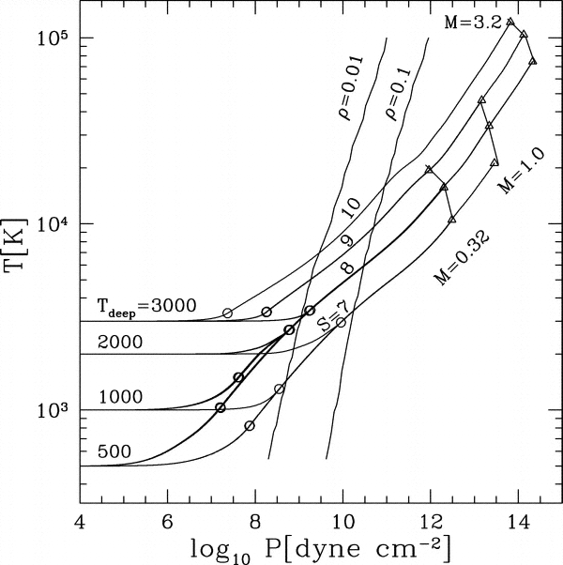
The radiative-convective boundary and the cooling rate
Arras & Bildsten (2006)
Guillot & Showman (2002)

Slide 3
Downward transport of kinetic energy?
Efficiency = (downward KE)/(incident flux) ≈ 1%
Showman & Guillot (2002)

Slide 4
Model set-up
same dynamics as Rauscher & Menou 2010, new radiative transfer

Slide 5
The code
Rauscher & Menou, in prep
Double-gray

Slide 6
The code
Rauscher
9/13/11
Rauscher & Menou, in prep
Double-gray
Infrared absorption coefficient increases with pressure

Slide 7
The code
Rauscher
9/13/11
Rauscher & Menou, in prep
Double-gray
Infrared absorption coefficient increases with pressure
At high optical depths transition to diffusion approximation for radiative flux

Slide 8
The code
Rauscher & Menou, in prep
analytic solution from Guillot (2010), see also Hansen (2008)

Slide 9
A range of internal heat fluxes
Globally averaged profiles
Sub- and anti-stellar profiles
P_{RCB} at 130, 50, and 20 bar.

Slide 10
Preliminary results

Slide 11
Average wind speeds
Preliminary

Slide 12
Zonal wind structure
Preliminary
T_{int}=125 K
T_{int}=350 K
T_{int}=500 K
T_{int}=1000 K
T_{int}=1410 K
T_{int}=2000 K

Slide 13
Temperature and wind maps at 1 bar
Preliminary
T_{int}=125 K
T_{int}=1000 K
T_{int}=1410 K
T_{int}=2000 K

Slide 14
Temperature and wind maps at 150 bar
Preliminary
T_{int}=500 K
T_{int}=1000 K
T_{int}=1410 K
T_{int}=2000 K

Slide 15
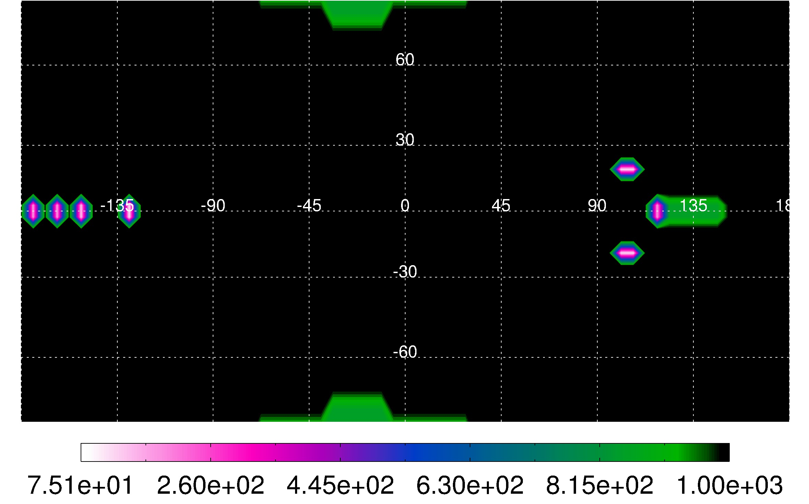
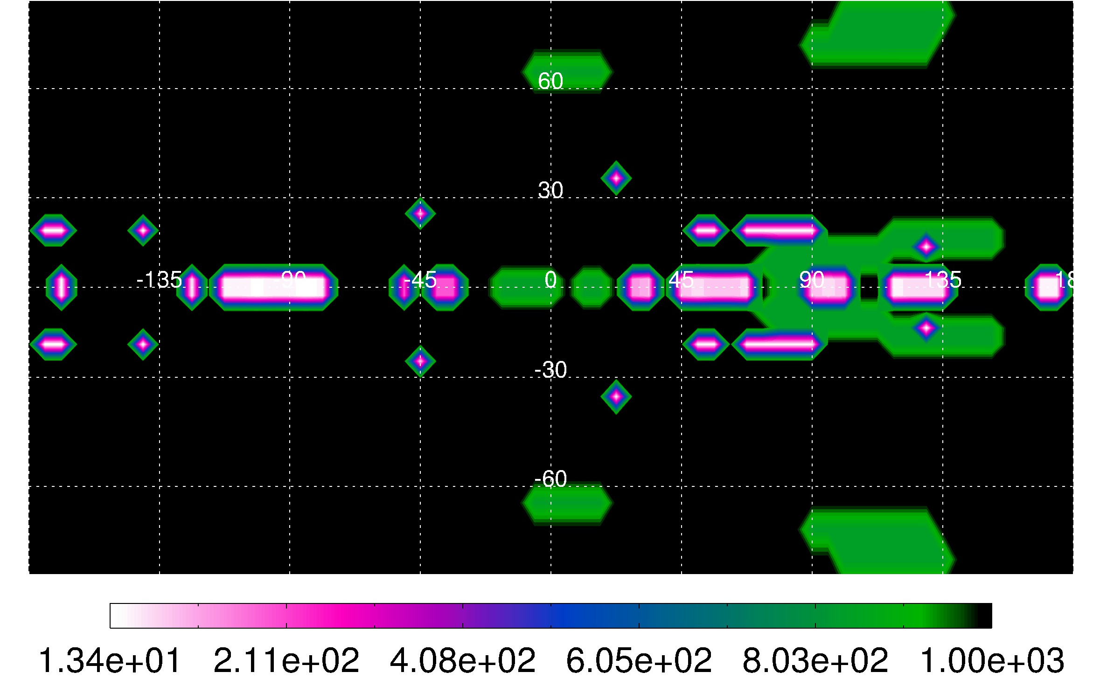
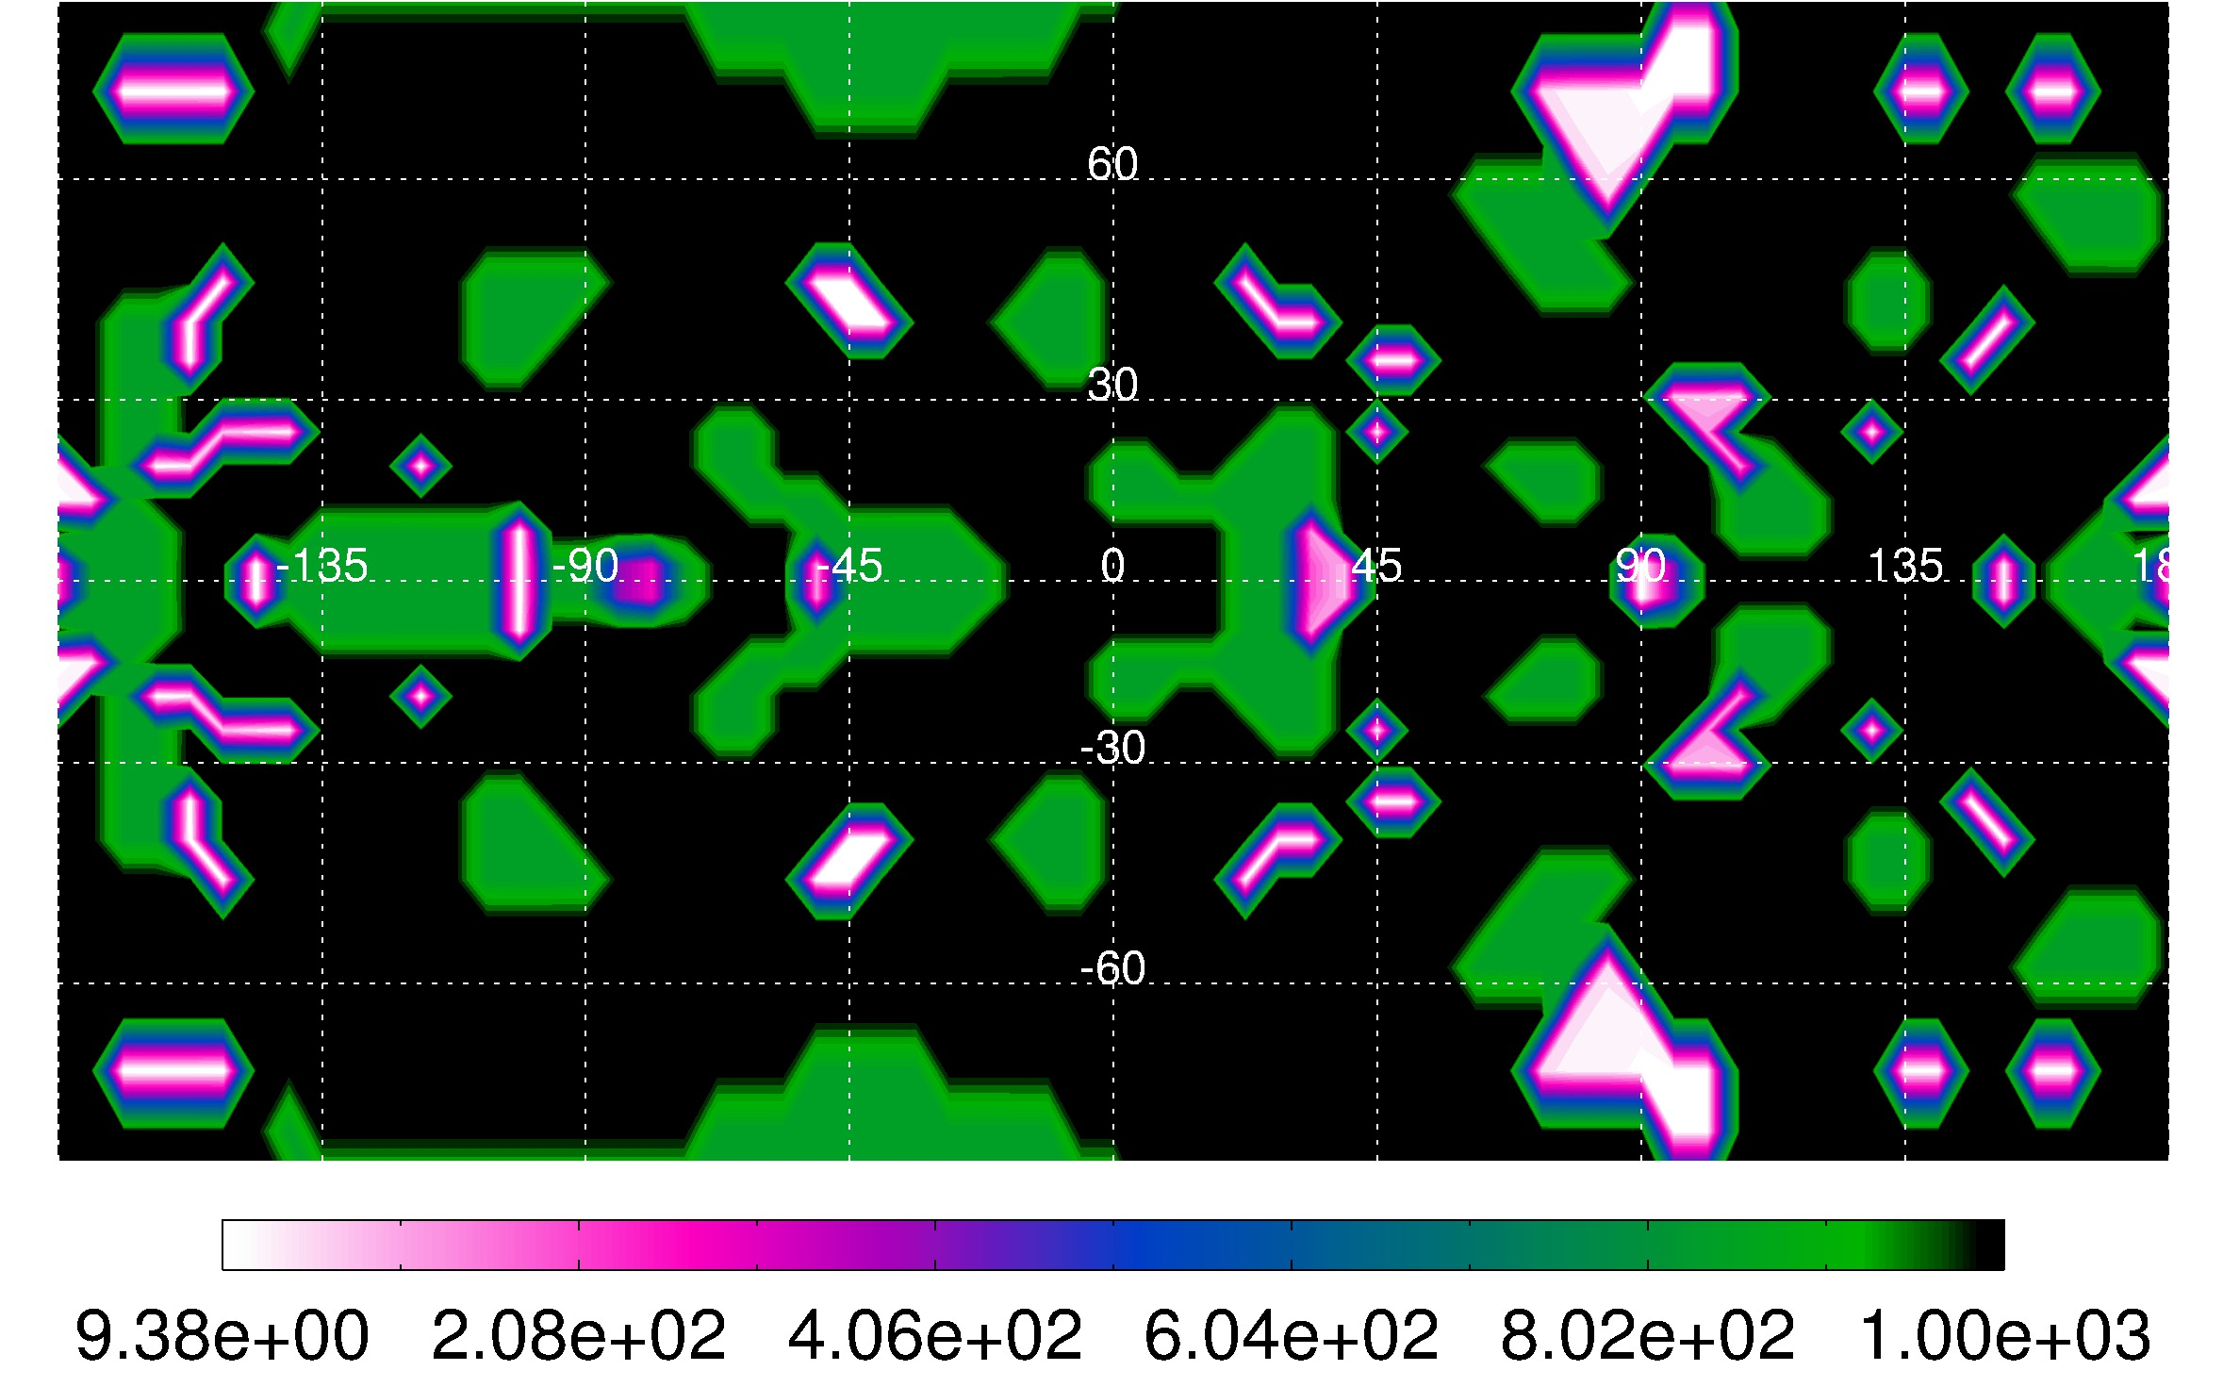
2-D radiative-convective boundary
Preliminary
T_{int}=1000 K
T_{int}=1410 K
P_{RCB,min} = 75 bar
P_{RCB,min} = 13 bar
T_{int}=2000 K
P_{RCB,min} = 9 bar

Slide 16
Efficiency of downward transport of E
Preliminary
downward kinetic energy
incident stellar heating
=

Slide 17
Summary
We see changes in the circulation across a range of internal heat fluxes
The location of the radiative-convective boundary is 2-D and complex (and requires further analysis)
The (preliminary) efficiencies we are finding are low, < 0.12%

