Slide 1
Effects of Kozai Migration on Formation of Close-in Planets
Soko Matsumura (University of Maryland)
Douglas P. Hamilton (University of Maryland)
Notes:
Kozai Migration of a Jupiter-like planet on formation of close-in, smaller-mass planetary systems

Slide 2
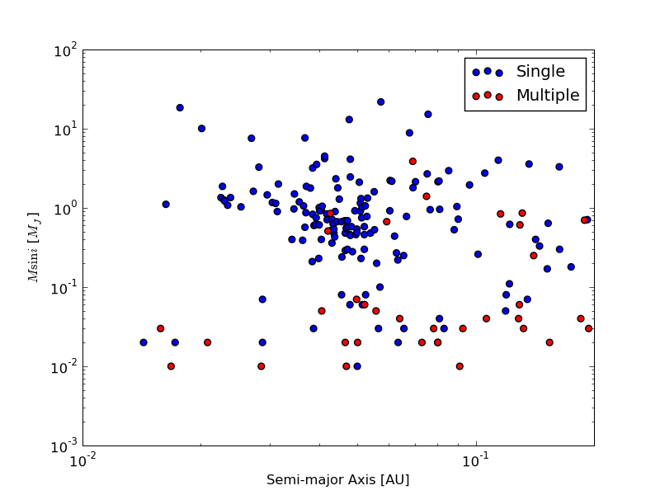
Motivation
Hot Jupiters tend to be singletons (e.g., Latham et al. 2011).
Multiple-planet systems prefer smaller planets (Talks by Lo Curto, Lissauer…).

Slide 3
Motivation
Hot Jupiters tend to be singletons (e.g., Latham et al. 2011).
Multiple-planet systems prefer smaller planets (Talks by Lo Curto, Lissauer…).
Formation of Hot Jupiters may affect formation and/or evolution of close-in multiple-planet systems.

Slide 4
Disk Migration
Kozai Migration/Capture
e.g., Lin et al. (1996), Trilling et al. (1998)
e.g., Fabrycky & Tremaine 2007, Wu et al. 2007, Nagasawa et al. 2008, Naoz et al. 2011, Talks by Naoz, Nagasawa, & Payne

Slide 5
e.g., Raymond, Mandell, & Sigurdsson (2006)
e.g., Lee & Peale (2002),
Moorhead & Adams (2005)
Potential Candidates: Kepler-11, HD 10180, Gl 876, HD 215497, HD 125612 etc.

Slide 6
Potential Candidates: Kepler-11, HD 10180, Gl 876, HD 215497, HD 125612 etc.
Potential Candidates: WASP-8, WASP-33, WASP-22, CoRoT-1, HAT-P-7 etc.

Slide 7
Motivation
Hot Jupiters tend to be singletons (e.g., Latham et al. 2011).
Multiple-planet systems prefer smaller planets (Talks by Lo Curto, Lissauer…).
Formation of Hot Jupiters may affect formation and evolution of close-in multiple-planet systems.
Some Hot Jupiters are likely formed via Kozai Migration (e.g., Fabrycky & Tremaine 2007, Wu et al. 2007, Nagasawa et al. 2008, Naoz et al. 2011, Talks by Naoz, Nagasawa, & Payne), rather than Disk Migration.
Stellar obliquity distribution (Triaud et al. 2010)

Slide 8
Goal
Estimate the probability of forming close-in Earths, Super Earths, or Hot Neptunes in the presence of a Kozai-Migrating Jupiter-like planet.

Slide 9
Method
Mercury (Chambers 1999) + Tides (e.g., Eggleton, Kiseleva, & Hut 1998)
f_{TF}: Tidal Friction Force
Q’ : Modified Tidal Quality Factor
Ω : Angular Velocity
I : Moment of Inertia

Slide 10
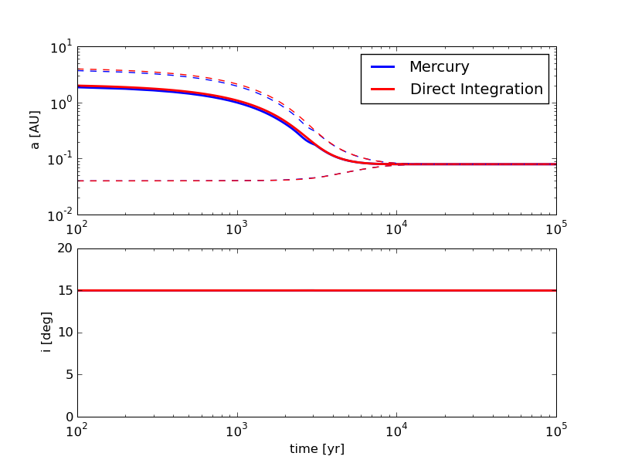
Method
Mercury (Chambers 1999) + Tides (e.g., Eggleton, Kiseleva, & Hut 1998)
M_{p} = M_{J}
a = 2 AU
e = 0.98

Slide 11
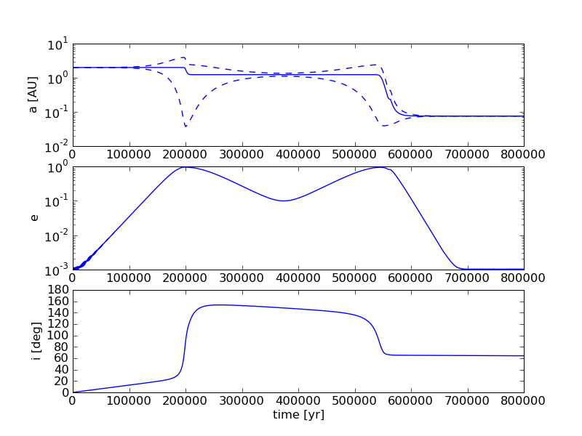
Method
Kozai Migration and Formation of a Hot Jupiter

Slide 12
Setup
10-30 AU
10M_{J}
2 AU
M_{J}
0.05 – 20 AU

Slide 13
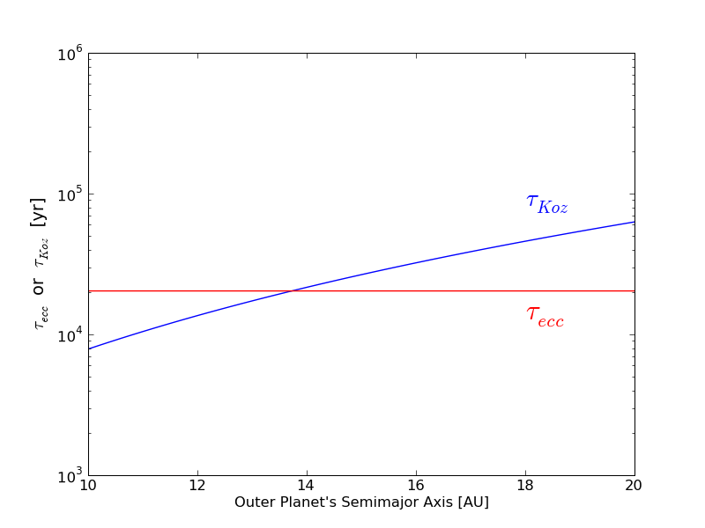
Setup

Slide 14
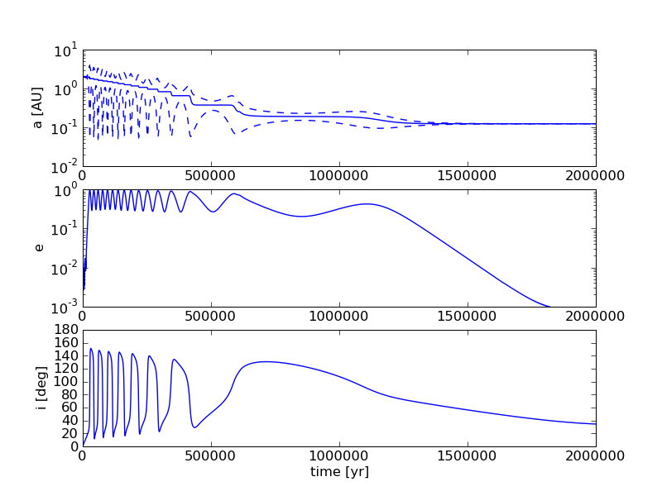
Result 1: Efficient Kozai Migration
Notes:
Tau_e > Tau_Koz

Slide 15
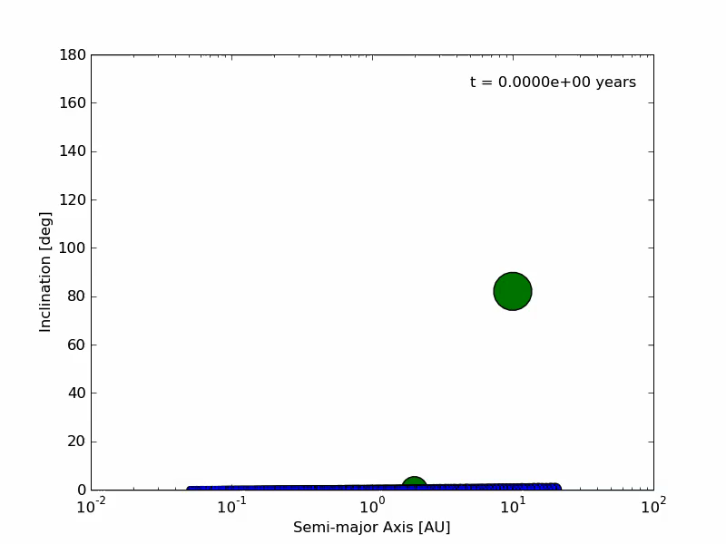
Result 1: Efficient Kozai Migration
Small planets can survive at large radii.
Notes:
Tau_e > Tau_Koz

Slide 16
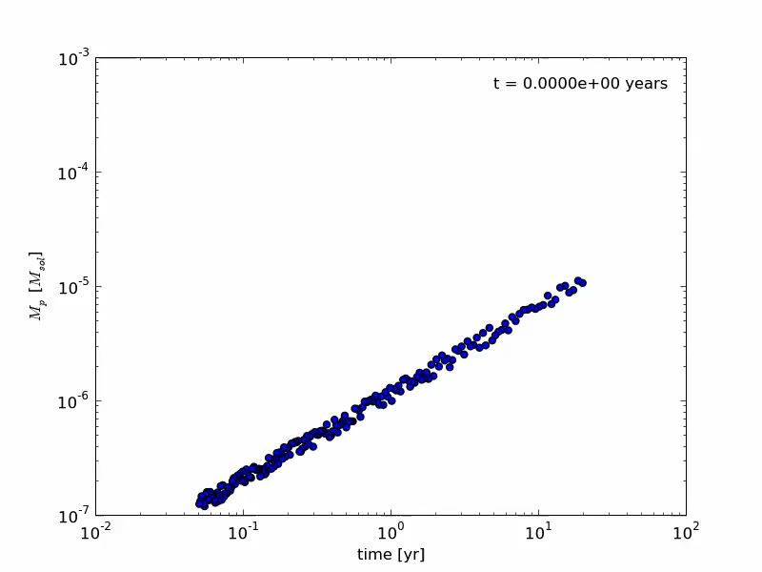
Result 1: Efficient Kozai Migration
Σ = 50 g/cm² (a/AU)^{-1.5}
Semi-major Axis [AU]
Notes:
Tau_e > Tau_Koz

Slide 17
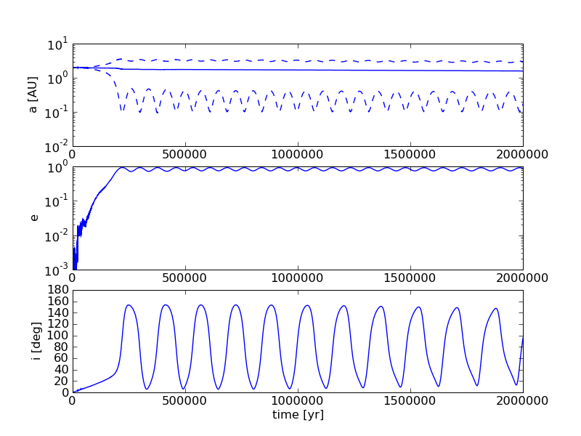
Result 1b: “Slow” Kozai Migration

Slide 18
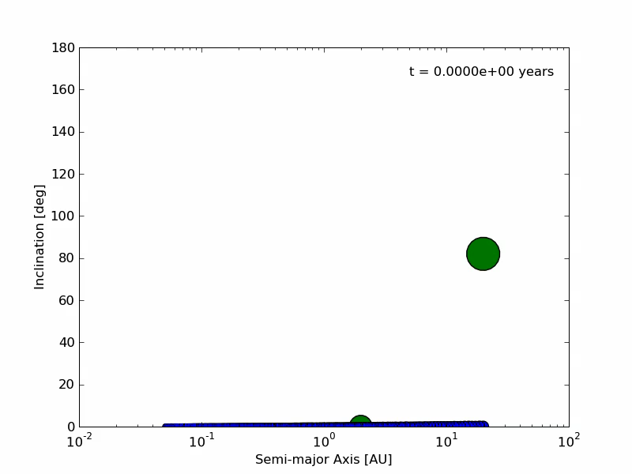
Result 1b: “Slow” Kozai Migration
All planetesimals are gone.

Slide 19
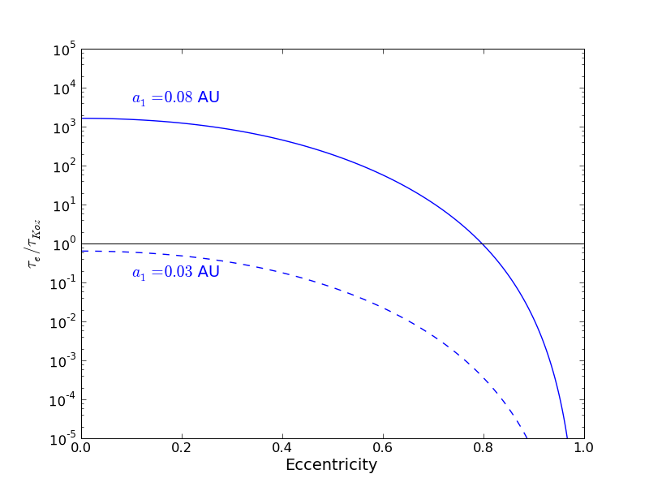
Tides on Planetary Embryos
Kozai Cycles are damped.

Slide 20
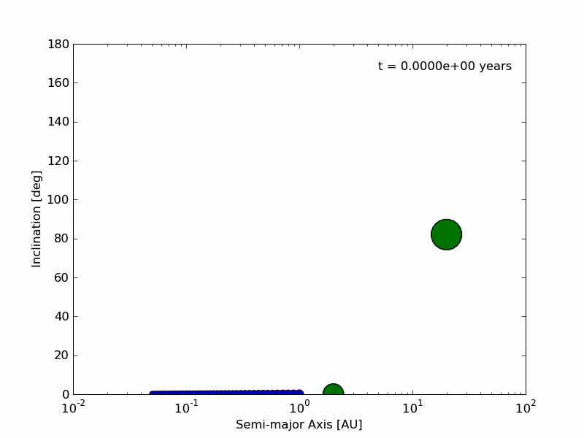
Result 2: Tides on Planetary Embryos
Kozai Migrating giant planets tend to remove tidally circularized planetary embryos/planets.

Slide 21
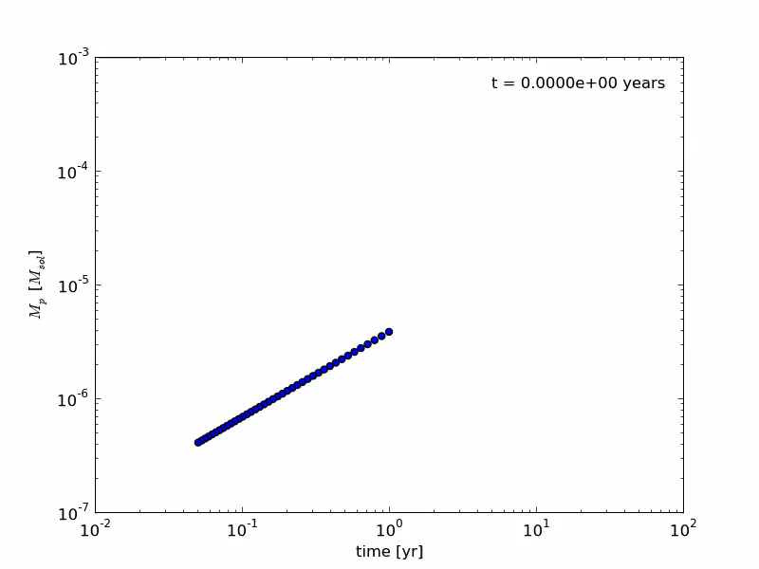
Result 2: Tides on Planetary Embryos
Σ = 50 g/cm² (a/AU)^{-1.5}
Semi-major Axis [AU]

Slide 22
Result 2: Tides on Planetary Embryos
Some could survive…

Slide 23
Summary
Study formation and survival of close-in planets during and after Kozai Migration of a giant planet.
Kozai Migration can be important for close-in planets/planetary embryos as well.
Kozai Migrating giant planet tends to remove low-mass planets interior to its orbit, but does not necessarily prevent formation of such planets.
Some low-mass planets could survive between two giant planets.

Slide 25
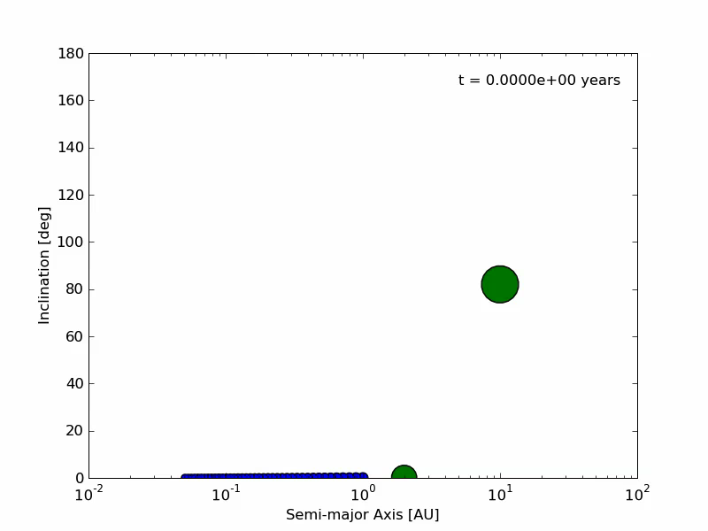
Result 2: Tides on Planetesimals

Slide 26
Result 2: Tides on Planetesimals

