Slide 1
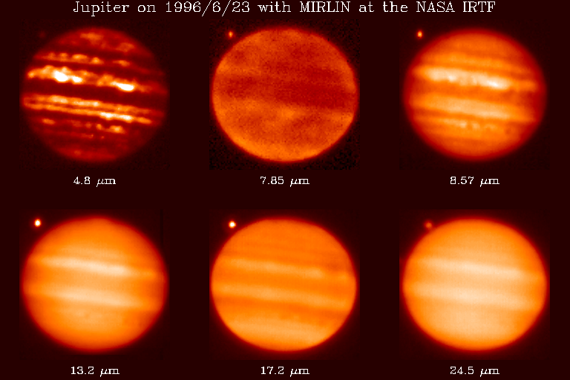
A Warm Spitzer Survey of Atmospheric Circulation Patterns
Image credit G. Orton
Heather Knutson (Caltech)
In collaboration with: N. Lewis (Arizona), N. Cowan (Northwestern), E. Agol (U Washington), A. Burrows (Princeton), D. Charbonneau (Harvard), D. Deming (Maryland), J. Desert (Harvard), J. Fortney (Santa Cruz), E. Kite (UC Berkeley), J. Langton (Principia), G. Laughlin (Santa Cruz), A. Showman (Arizona)
Notes:
Nikole has been instrumental in developing new analysis techniques to deal with warm Spitzer data.

Slide 2
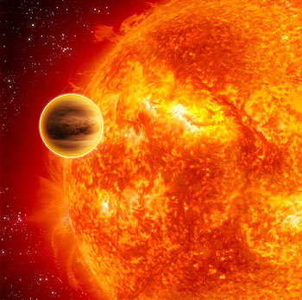
Goals for hot Jupiters:
Test basic predictions of circulation models.
Understand how/why circulation patterns vary.
What does this tell us about the relevant physical processes in these atmospheres?
Image credit: ESA/C. Carreau
Notes:
Most models agree on these general predictions. Two questions to address here: (1) are the most basic predictions correct, and (2) what do the differences in circulation (either with depth/wavelength, or from one planet to the next) tell us about the underlying physics at work in these atmospheres?
RHINES LENGTH- scale at which planet rotation causes east-west jets (9000 km for Jup, 180,000 km for hot Jupi)
ROSSBY DEFORMATION RADIUS- scale at which pressure perturb. are resisted by Coriolis force (vortices often have horizontal sizes ~deform radius)
The Rhines length is L_beta = pi * sqrt(U/beta), where on a sphere beta = 2*Omega*cos(phi)/a, Omega is the rotation rate, phi islatitude, and a is planetary radius. For Jupiter, this givesroughly Omega=1.7e-4/sec and beta=4.9e-12/(m sec) at the equator.Jupiter's winds at the equator reach 150 m/sec, but the Rhines scalingapplies better to the midlatitudes, where the winds are about 30-40 m/sec.Using the above value of beta and putting in U=40 m/sec, we getL_beta ~ 9000 km.For hot Jupiters, beta is significantly smaller (assuming a synchronouslyrotating planet) and the wind speed U is probably significantly faster.If you put in U=2 km/sec and assume a 3-day rotation period and a planetwith a radius of 80,000 km, you have beta = 6e-13/(m sec), and this givesL_beta = 180,000 km.
Rossby deformation radius=NH/f
f ≡ 2Ω sin φ is the Coriolis parameter, H is the scale height, and N is the Brunt-V¨ais¨ al¨a frequency, i.e., the oscillation frequency for a vertically displaced air parcel in a statically stable atmosphere

Slide 3
Why care about circulation? We are currently treating 3D atmospheres like 1D objects.
Temperature Map for HD 189733b (Showman et al. 2009)
Local differences in composition and thermal structure can alter shape of observed spectra.
Latitude
30 mbar
Longitude
Is this a reasonable or an unreasonable assumption?
We have no idea!
Notes:
Transit surveys are biased towards short-period, slowly rotating, likely tidally locked objects. As long as these are our targets, circulation will be important in understanding these atmospheres. This is still true for super-Earths!

Slide 4
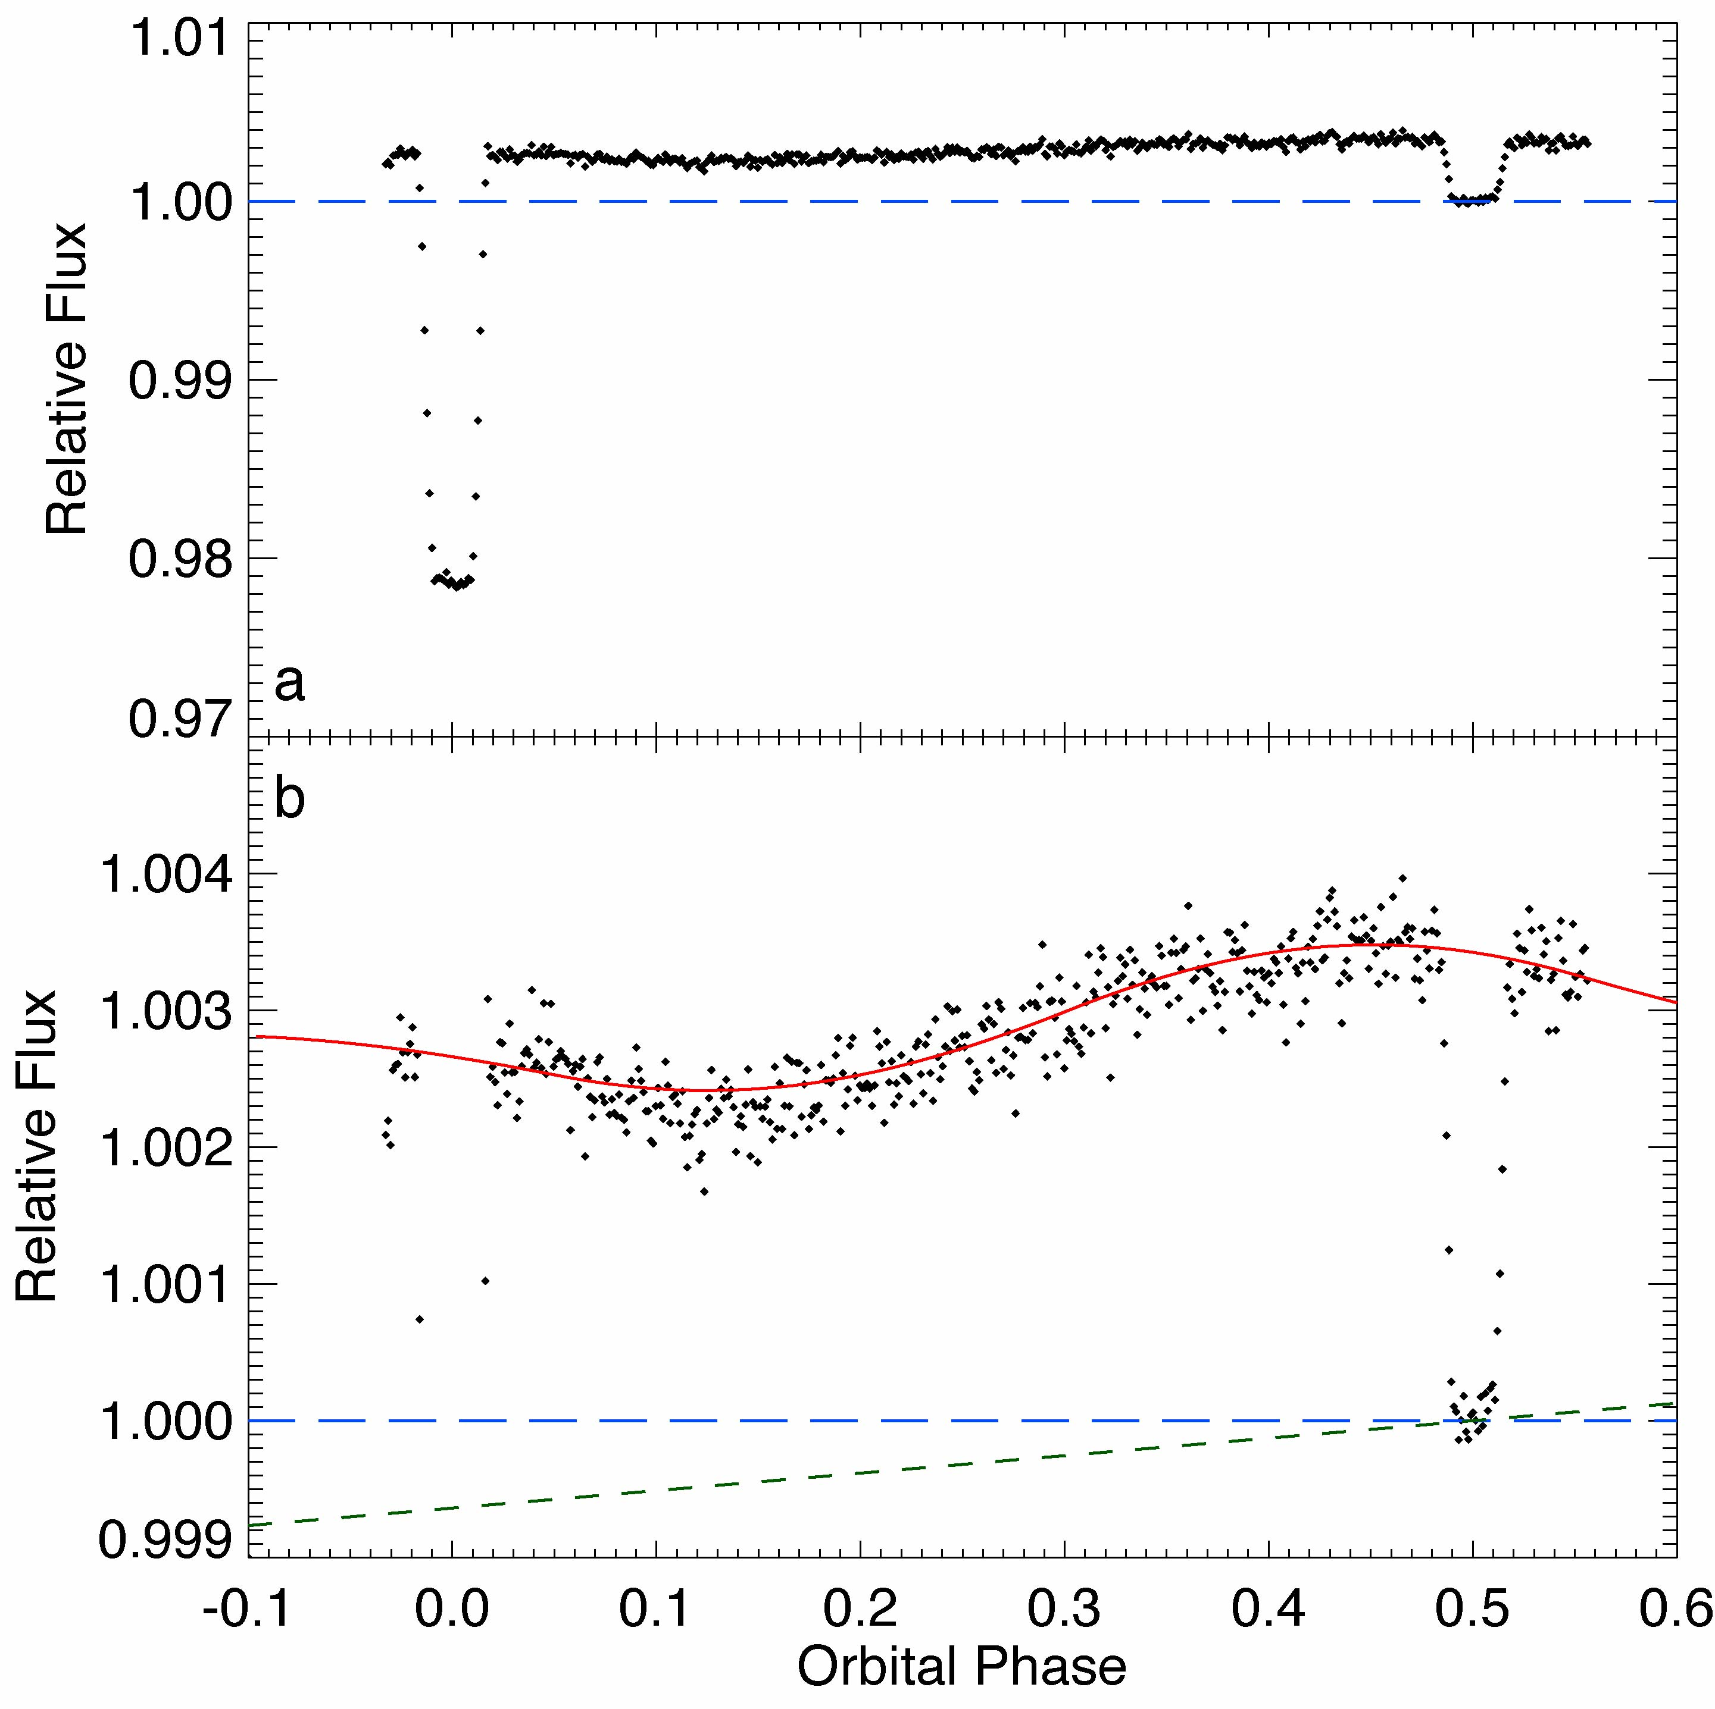
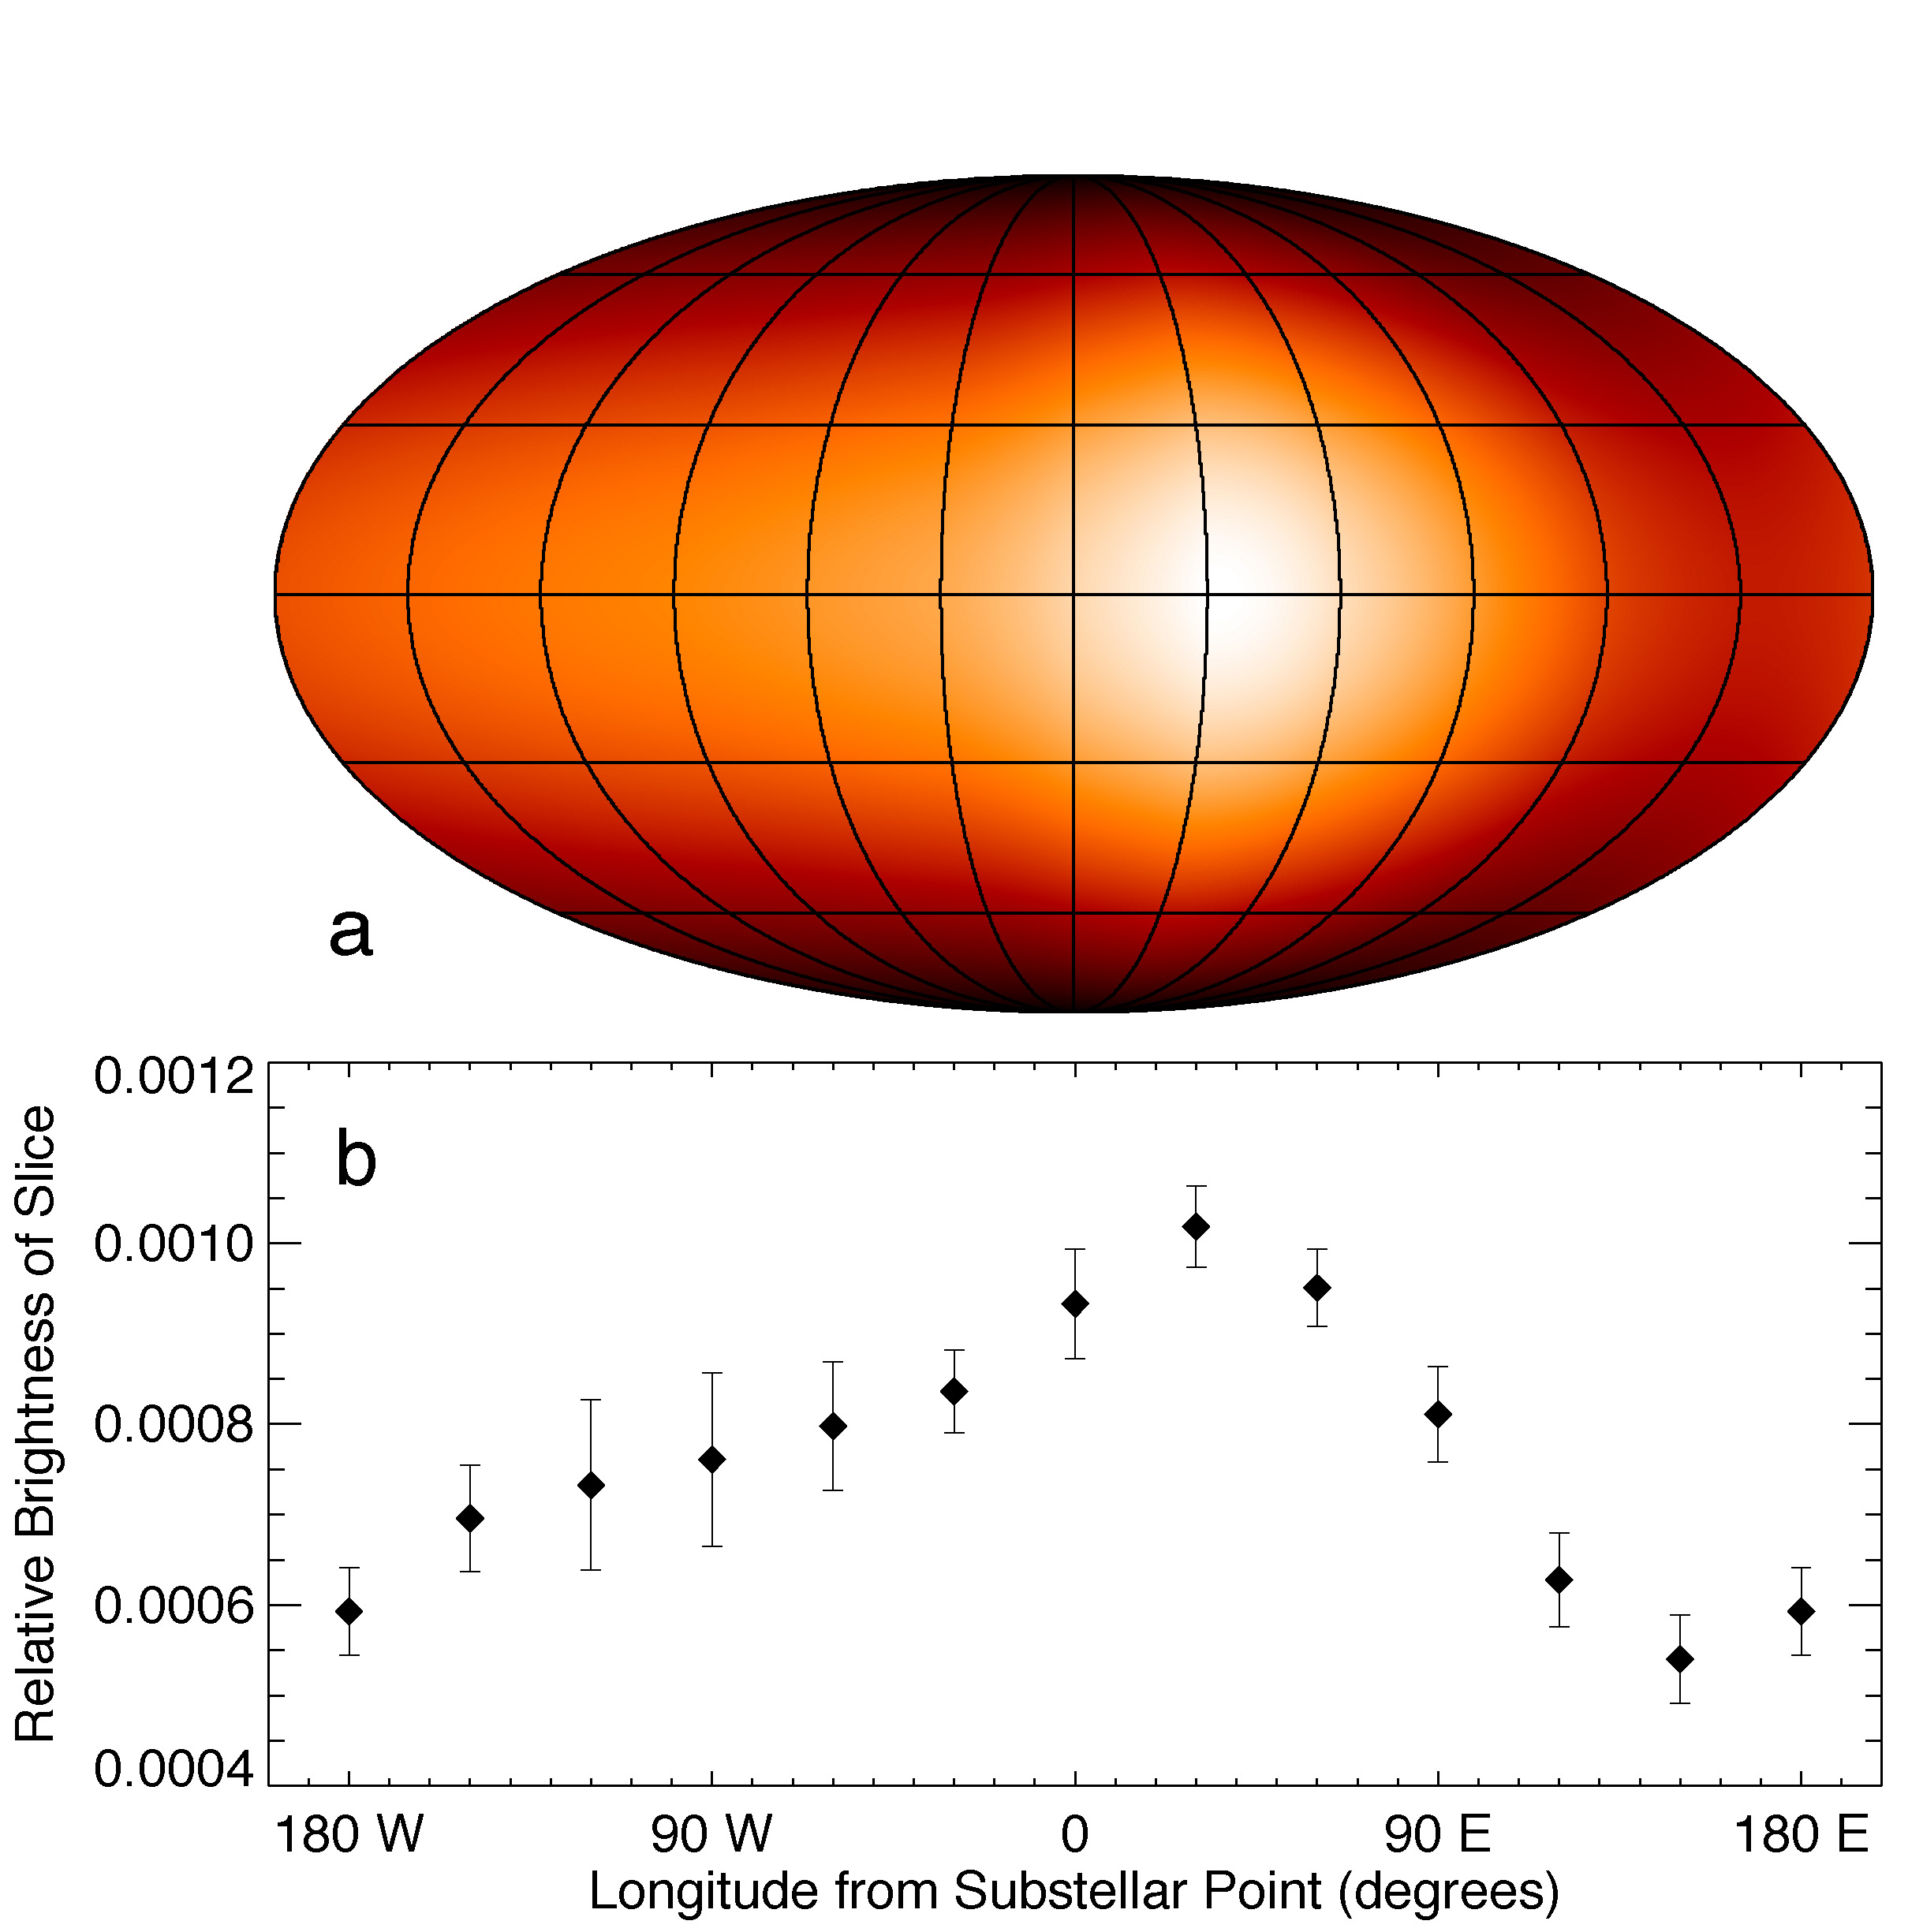
First Longitudinal Temperature Profile for an Exoplanet: HD 189733b’s Hot Night Side at 8 μm
1200 K
1000 K
1000 K
1200 K
Observer’s view of planet
Spitzer 8 μm observations of HD 189733b (Knutson et al. 2007b)
Notes:
Main results: Small day-night temperature gradient, differing offsets in positions of hot and cold regions.

Slide 5
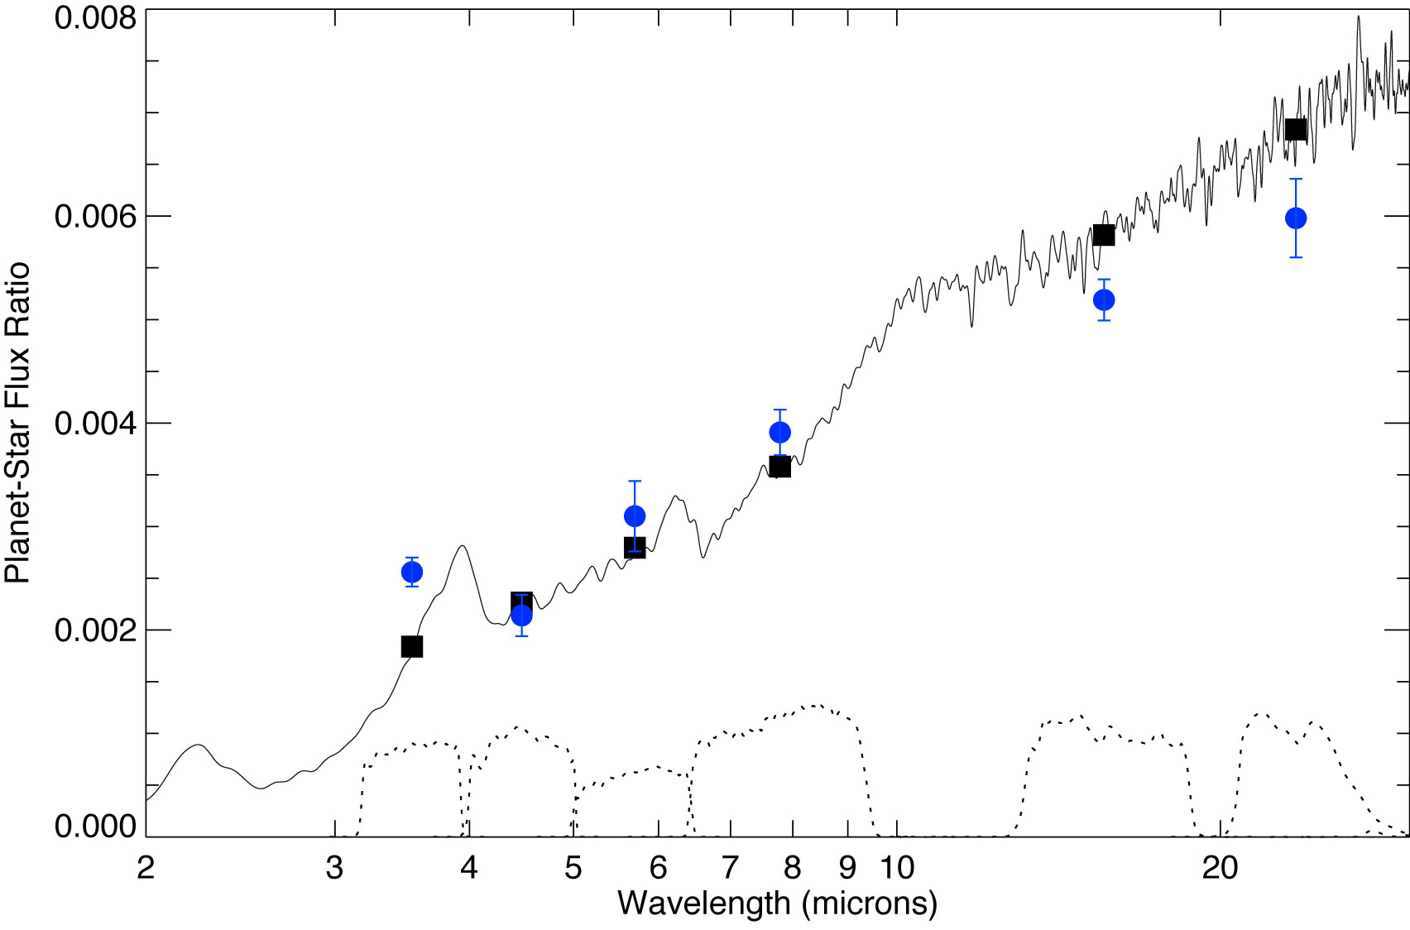
A Broadband Emission Spectrum For HD 189733b Charbonneau, Knutson et al. (2008), Barman (2008)
We just calculated a temperature based on a single band! That can’t be correct….
Model
Data
Want spectrum as a function of orbital phase.

Slide 6
New Warm Spitzer Observations
Multi-wavelength (3.6, 4.5 + old 8.0, 24 μm).
Full orbit
(75 hours).
But where is the phase curve?
3.6 μm
4.5 μm

Slide 7
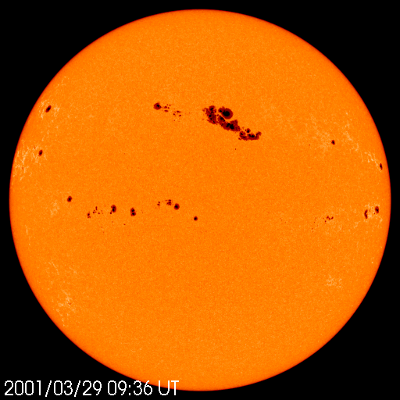
Pixel Maps & Star Spots
The brightness of the star can vary as spots rotate in and out of view.
Ballard et al. (2010)
Relative Flux
12 day rotation
Winn et al. (2007)
Photometric Phase
Fit data simultaneously to determine pixel response as a function of x and y position, linear slope due to stellar rotation, and planet phase curve.
Notes:
MCMC!

Slide 8
Final Corrected HD 189733b Light Curves
3.6 μm
4.5 μm
Flux from star alone
Observer’s view of planet
Amplitude: 0.0913% ± 0.0039%
ΔT = 311 ± 15 K
Amplitude: 0.1295% ± 0.0078%
ΔT = 374 ± 31 K
See Cowan & Agol (2008) for description of functional forms for phase curve fits.
Notes:
Minimum occurs *before* the transit!! Feature observed in 8 micron data is likely a detector effect related to the detector ramp, which we didn’t know about at the time of that publication. 8 micron contrast is either 247 +/- 51 K or 160 +/- 51 K, and 24 micron contrast is 236 +/- 48 K or 188 +/- 48 K.

Slide 9
Comparison to 1D Atmosphere Models Burrows et al. (2008), Grillmair et al. (2008)
Night Side
How well can we infer night side properties based on dayside spectra?
Day Side
Solar composition, equilibrium chemistry, extra absorber κ with opacity 0.035 cm²/g, 15% of incident flux transported at depth to the night side.
Model
Data
Notes:
How well can we infer night side properties based on fits to the dayside spectrum?
Heat sink is between 0.01-0.1 bars.

Slide 10
Comparison to 3D Atmosphere Models Showman, Fortney et al. (2009)
New data. Errors are 7-10x smaller!
Solar, 5x solar
Notes:
Evidence for extra absorption at 4.5 microns on the night side?? Curent models assume LTE chemistry.

Slide 11
A Growing Diversity of Circulation Patterns
4 mag. fainter
HAT-P-7b
3.6 μm
8x smaller
HD 149026b
4.5 μm
HAT-P-7b is very hot (~2500 K)… could MHD effects brake the atmospheric flows?
HD 149026b likely has a high metallicity. Could increasing the opacity result in larger temperature gradients?
Observer’s view
Notes:
K=5.5 for 189, 9.3 for HAT7, 6.8 for 149

Slide 12
HD 189733b with Warm Spitzer
3.6 μm
4.5 μm
Observer’s view of planet
Highlights:
Spectrum as a function of orbital phase -> chemistry, P-T profiles
Max/min offsets consistent with a simple super-rotating equatorial jet.
Emerging evidence for large day-night T gradients on some planets.
Notes:
Minimum occurs *before* the transit!! Feature observed in 8 micron data is likely a detector effect related to the detector ramp, which we didn’t know about at the time of that publication. Night side is 41+/- 3% of dayside flux at 3.6 um, 30+/-4% of dayside flux at 4.5 um. 8 micron contrast is either 247 +/- 51 K or 160 +/- 51 K, and 24 micron contrast is 236 +/- 48 K or 188 +/- 48 K.

Slide 13
Overlapping data sets allow for consistency checks on corrections.
3.6 μm
4.5 μm
Y Position (pixels)
X Position (pixels)
X Position (pixels)

Slide 14
Spot Variations for New Obs.
Ground-based photometry in (b+y)/2 from Greg Henry’s APT telescope.

Slide 15
3.6 μm Parameter Distributions from MCMC Fits
Notes:
8 micron peak occurs 2.5 +/- 0.9 hours before secondary eclipse, 24 micron peak occurs 5.5 +/- 1.2 hours before secondary eclipse. So in general, longer wavelengths show smaller temperature gradients and larger offsets in location of the peak. Other feature of note is that minima appear on average to be shifted more than the maxima.

Slide 16
4.5 μm Parameter Distributions from MCMC Fits

Slide 17
Observed as part of CoRoT-7 program, PI Francois Fressin
Ramp as a function of illumination level for a 1-hour observation of a bright, diffuse HII region.
Notes:
Observed as part of CoRoT-7 program, PI Francois Fressin.

Slide 18
HD 189733b, Charbonneau et al. (2008)
Old:
New:
0.256±0.014%
0.150±0.002%
0.214±0.020%
0.182±0.002%

Slide 19
HD 189733 at Two Wavelengths
HD 189733 at 8 μm
Knutson et al. (2007b)
Same day-night temperature gradient from both light curves.
Why so similar? Two possibilities:
Both wavelengths originate from the same pressure
Day-night contrast is similar over the relatively modest factor of ~2-3 in pressure sensed by these two wavelengths
HD 189733b at 24 μm
Knutson et al. (2009a)

Slide 20
Comparison to 1D Atmosphere Models
New errors are 7-10x smaller!

