Slide 1
Atmospheric circulation of hot Jupiters on highly eccentric orbits
Tiffany Kataria¹, Adam Showman¹, Nikole Lewis¹, Jonathan Fortney², Mark Marley³, Richard Freedman³
September 15, 2011
¹University of Arizona, ²UCSC, ³NASA Ames

Slide 2
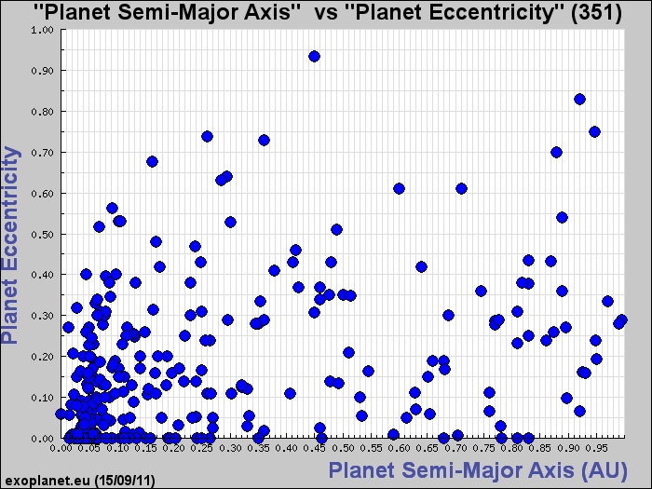
HD80606b
HAT-P-2b

Slide 3
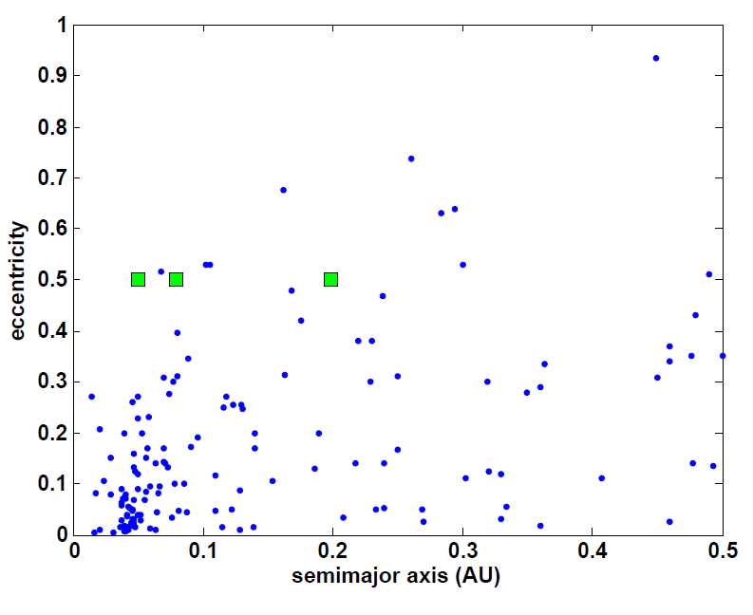
Simulations of generic hot Jupiters on highly eccentric orbits
Assume mass, radius, and gravity of generic hot Jupiter
Atmospheric composition of 1x solar (without TiO/VO) in chemical equilibrium
Varied parameters
Eccentricity: from circular (e=0.0) to highly eccentric (e=0.75)
Average stellar flux: 1x, 2x, 4x, 8x nominal avg stellar flux
Notes:
Emphasize that for pseudo-synchronous rotators, all parameters are the same as the synchronous cases except the rotational period
Put graph

Slide 4
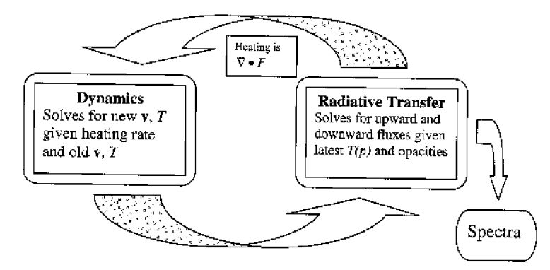
SPARC Model Atmosphere Substellar and Planetary Atmospheric Radiation and Circulation Model
Showman et al. (2009)
MITgcm
Solves 3-D primitive equations
Radiative Transfer
Based on RT model by Marley and McKay (1999)
Plane-parallel, two-stream
Opacities binned using correlated-k method
Eccentric Planet Considerations
Distance varies with time
Assume pseudo-synchronous rotation using Hut (1981) formulation
Notes:
Cubed sphere spacing does not converge to zero at poles, like lat-lon grid
Has 8 special corner points, but still remain reasonably spaced close to the points
Can have long time steps than a lat-lon at a similar resolution
Plane parallel
Two stream—solve for upward and downward fluxes; includes both incident radiation from the parent star and thermal radiation from the planet’s atmosphere and interior
Put in schematic
Correlated k method—opacities are first computed at millions of individual freq points at over 700 P-T points, then sum opacities at each P-T point. Then, divide frequencies into bins (in this case, 30) and sort opacities by strength

Slide 5
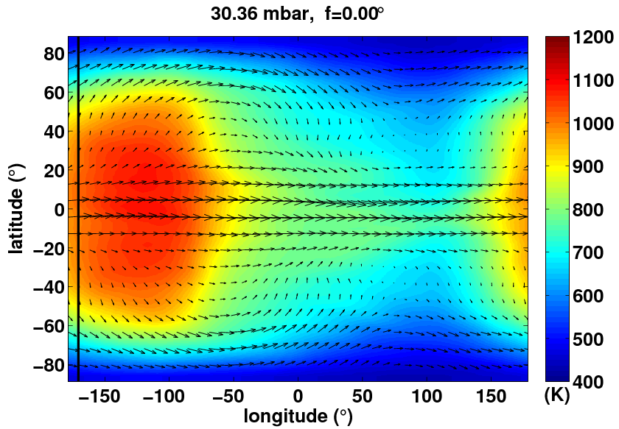
Dynamical regime
Equatorial eastward superrotating jet, westward jets at mid-latitudes
Flash heating event at periapse passage
Hot spot shifted eastward of substellar point due to dynamics
Notes:
Check to see if there are any of these plots on sky for newgrid-007

Slide 6
Observational Implications
Peak temp lags
peripase passage
Dynamics shift hot
spot east of SS point
Depending on
observing geometry,
hot/cold sides rotate
in/out of view at
different times
Lightcurves will be shaped by both factors
~6 hr
lag
Notes:
For a given orbit, will know orbital geometry, and will therefore be able to extract these properties

Slide 7
Effect of orbital viewing geometry
to Earth
ϖ=0°
periapse
apoapse
ϖ=90°
periapse
apoapse
to Earth
Notes:
Add arrows

Slide 8
a=0.0534 AU, e=0.50, T_{orb}=4.94d, T_{rot}=1.75d, ϖ=0°
Transit
Secondary eclipse
Secondary eclipse
Transit
Peak flux ~14 hours after periapse
24
16
8.0
5.8
4.5
3.6
Notes:
Peak temp here occurs a bit over ½ a day. However, in plots of avg temperature, the peak occurs after ~6 hours.
Note when peak flux occurs

Slide 9
a=0.0534 AU, e=0.50, T_{orb}=4.94d, T_{rot}=1.75d, ϖ=90°
Transit
Transit
Secondary eclipse
Secondary eclipse
24
Peak flux ~4 hours after periapse
16
8.0
5.8
4.5
3.6
Notes:
Ringing does not seem to have definite period, unlike in Cowan and Agol (2011). More work is needed to correlate the ringing with the location of the hotspot. Presumably this is the hot spot rotating in and out of view. Perhaps this has something to do with doppler shifts as the winds point to and away from Earth
Here, peak temp occurs probably occurs at around periapse passage, not at ½ or 6 hours as seen before. Therefore, orbital geometry does largely affect what you see

Slide 10
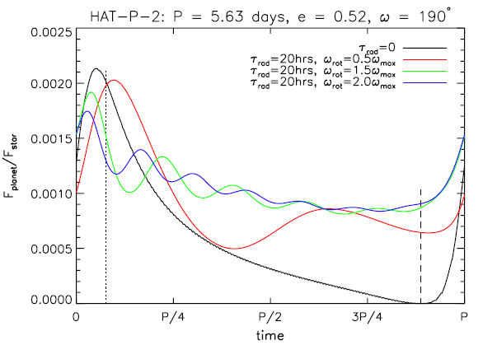
Cowan and Agol (2011)
Notes:
1.75d vs 1.89d
In Cowan & Agol, they found that sub rotating winds led to a peak in flux after transit, while superrotating winds led to a peak in flux before transit. So, our models do agree with their conclusions. Adding viewing geometry adds another layer of complexity. At omegabar=90, there are two peaks before secondary eclipse.

Slide 11
a = 0.0848 AU, e=0.50, T_{orb}=9.89d, T_{rot}=3.53d, ϖ=0°
Transit
Secondary eclipse
Peak flux ~1 day after periapse
No ringing!
24
16
8.0
5.8
4.5
3.6
Notes:
Equator to pole temp diff is less. On the whole much cooler, therefore amplitude is less
In Tave plots, peak temp occurs after 12-13 hours
In lightcurve, this is more like 1 day
Depends on viewing geometry!!

Slide 12
a = 0.2135 AU, e=0.5, T_{orb}=39.53d, T_{rot}=14.09d, ϖ=0°
Transit
Secondary Eclipse
Peak flux ~1 day after periapse
24
16
8.0
5.8
4.5
3.6

Slide 13
Conclusions
We present three-dimensional circulation models coupled with non-grey radiative transfer for a number of generic eccentric (e=0.5) hot Jupiters
The dynamics of the flow, coupled with the rotation rate and viewing geometry with respect to Earth can lead to degeneracies in the interpretation of disk-integrated lightcurves.
Close-in cases of eccentric hot Jupiter exhibit similar “ringing” seen in Cowan and Agol (2011). This ringing lacks periodicity because of the variation of wind speeds and day/night temperature variations with orbital distance.
Notes:
My guess is the rotation rate plays the largest role in the ringing, although things like gravity and radiative timescales could also affect the structure

Slide 14
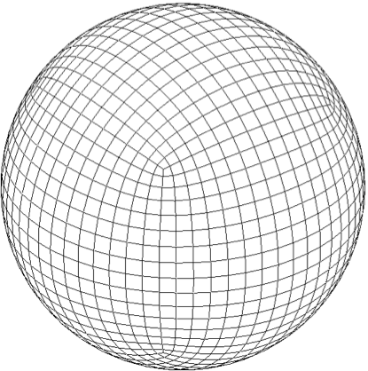
SPARC Model Atmosphere Substellar and Planetary Atmospheric Radiation and Circulation Model
MITgcm
Solves 3-D primitive equations
$$\frac{dv}{dt}=−∇Φ−fk ×v$$
$$\frac{∂Φ}{∂p}=−\frac{1}{ρ}$$
$$∇∙v+\frac{∂ω}{∂p}=0$$
$$\frac{dT}{dt}=\frac{q}{c_{p}}+\frac{ω}{ρc_{p}}$$
Radiative Transfer
Based on RT model by Marley and McKay (1999)
Plane-parallel, two-stream
Opacities binned using correlated-k method
Cubed sphere grid
Notes:
Cubed sphere spacing does not converge to zero at poles, like lat-lon grid
Has 8 special corner points, but still remain reasonably spaced close to the points
Can have long time steps than a lat-lon at a similar resolution
Plane parallel
Two stream—solve for upward and downward fluxes; includes both incident radiation from the parent star and thermal radiation from the planet’s atmosphere and interior
Correlated k method—opacities are first computed at millions of individual freq points at over 700 P-T points, then sum opacities at each P-T point. Then, divide frequencies into bins (in this case, 30) and sort opacities by strength

Slide 15
Eccentric Extrasolar Planet Considerations
Distance varies with time
$$r\left(t\right)=a(1−e\cos{E\left(t\right)})$$
$$M\left(t\right)=E\left(t\right)−e\sin{E(t)}$$
$$M\left(t\right)=n(t−τ)$$
Planetary rotation rate is likely non-synchronous
Use pseudo-synchronous formulation from Hut (1981)
$$τ_{rot}=τ_{orb}\left[\frac{(1+3e^{2}+{3e^{4}}/8) ({1−e^{2})}^{3/2} }{1+{15e^{2}}/2+{45e^{4}}/8+{5e^{6}}/{16}}\right]$$
a
E
a
r
ϖ
f
Notes:
M = mean anomaly
E = eccentric anomaly
Assume synchronous rotation save for one

Slide 16
Why the narrower jet? Rossby Deformation Radius (L_{R})
Hz length scale for atmospheric phenomena affected by both rotation and buoyancy waves (gravity waves)
Given at equator by
where β = Beta parameter, df/fz
c = gravity wave speed
f = Coriolis parameter = 2Ω sinφ
By Hut (1981) formulation, rotation period proportional to orbital period, which in turn is inversely proportional to the deformation radius
$$L_{R}=\sqrt{\frac{c}{β}}$$

Slide 17
What pumps the jet? Eddy momentum flux
Eddy momentum flux: contribution of momentum transport by turbulent eddies
Calculate u*v*, the meridional flux of eastward momentum
u* and v* are the deviations of zonal and meriodional winds from their zonal averages
If u*v* > 0, northward flux of eastward momentum
If u*v* < 0, southward flux of eastward momentum

Slide 18
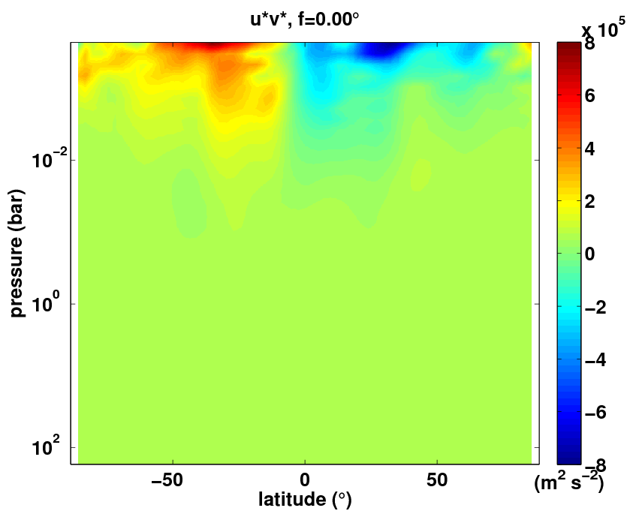
What pumps the jet? Eddy momentum flux
Eastward momentum is being transported equatorward
This flux maintains the equatorial jet against westward accelerations caused by advection, friction, and Coriolis forces
Notes:
Standing eddies formed by the strong day-night heating contrast induce a flux of momentum from midlatitudes to the equator, helping to maintain the superrotating equatorial jet.
Eddy momentum fluxes peak just after periapse passage
Lead to variations in the zonal-mean flow throughout the orbit

