Slide 1
Nonlinear Tides in Exoplanet Host Stars
Phil Arras University of Virginia
Josh Burkart U. C. Berkeley
Eliot Quataert U. C. Berkeley
Nevin Weinberg MIT
Paper submitted to ApJ (arXiv:1107.0946):
“Nonlinear Tides in Close Binary Systems” by Weinberg, Arras, Quataert & Burkart
(Extreme Solar Systems II)
Notes:
Today I’ll be talking about Nonlinear Tides is Exoplanet Host Stars.
My collaborators are …

Slide 2
observational motivation
Direct detection of tidal motions raised in star by planet:
Ellipsoidal (flux) variation (Sirko & Paczyn ́ski 2003; Loeb & Gaudi 2003; Pfahl et al. 2008).
Detection for Hat-P-7 b by Kepler (Welsh et al. 2010).
Talk by Brian Jackson on Hat-P-7 b.
Tidally induced radial velocity variation (e.g. Terquem et al 1998).
Possible detection for WASP-18 b (Arras et al 2011, Triaud et al 2010).
(This talk) Secular tidal evolution due to tidal dissipation:
Orbital circularization (e.g. Terquem et al 2000, Goodman and Dickson 2000, Ogilvie and Lin 2007).
Decay of the orbit (e.g. Ogilvie and Lin 2007; Jackson et al 2009)
Alignment of the stellar spin with the orbit (e.g. Barker and Ogilvie 2009)
Notes:
Two observational aspects of tides raised in the star by the planet’s gravity.
On orbital timescales, time-variable tides induce temperature perturbations and fluid motions in the star
which we can detect as ellipsoidal variation in flux or radial velocity variation.
Mention the two examples.
For radial velocity, point out that if planet big and close, and orbit pointing toward us, it may be tides.
2) Second reason to study tides is they can cause evolution of the orbits and spins, on Myr or Gyr timescales. This is due to the much more subtle effect of tidal dissipation, which is due to taking fluid motions and irreversibly turning them into heat. This dissipation causes a lag between tidal force and fluid response.
There can be several effects of this tidal dissipation:
circularization of the orbit,
decay of the orbit toward the star,
and alignment of the stellar spin with the orbit axis.
Here we’ll focus on orbit decay.

Slide 3
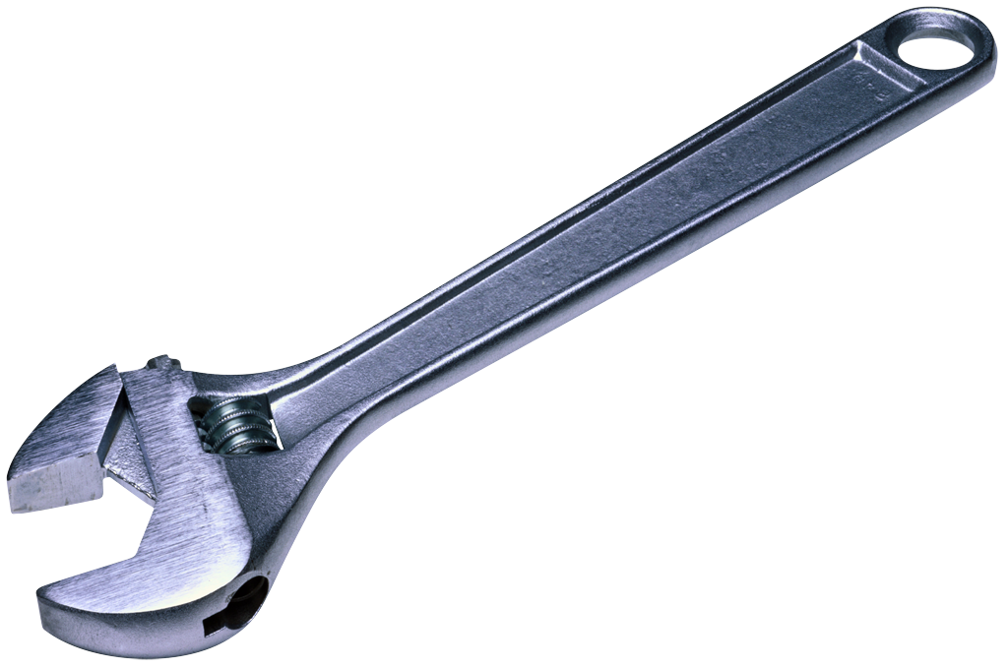
the 1 slide tidal Q review
By analogy with the
``quality” of a damped,
driven oscillator:
δ
Q is related to the
lag angle
of the tidal bulge
δ
standard operating procedure:
Q = constant
independent of frequency and amplitude
calibrated from one observation and
applied to another
(G. Darwin)
Notes:
Review the basic ideas behind secular tidal evolution.
Q not really a good parameter as you don’t want potential energy, just kinetic as that’s what is dissipated.
Gravity of planet can grab onto the misaligned tidal bulge and torque the star.

Slide 4
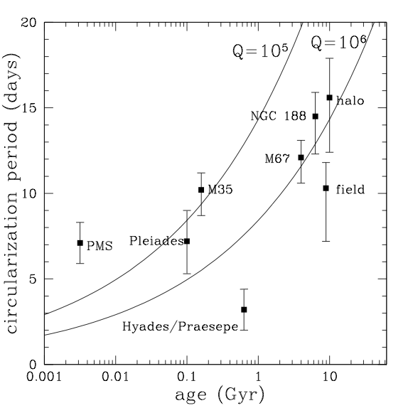
What is Q for planet host stars?
Calibration of Q using
the observed circularization
of binaries with two solar-
type stars:
Forcing periods: ~ 10-15 days
(planets: 1-7 days)
But this observed Q is not
well explained by theory!
Theory underpredicts
tidal dissipation rate.
(Goodman and Dickson, Terquem et al,
Savonije and Witte, Ogilvie and Lin)
(data from Meibom and Mathieu 2005)
Notes:
So what is Q for planet host stars.
If you use Q calibrated from the ongoing circularization with age
Found from clusters.

Slide 5
Orbital decay of exoplanets?
Sun-like stars rotate slow compared to planet orbit ( ).
Tide raised in star by planet spins star up.
Orbit must decay inward to conserve total angular momentum.
Insufficient J in orbit to synchronize star inside P_{orb} ≈1 week.
Example: WASP 18-b has and .
For
If true, orbit decay is ongoing, even for Gyr old planets.
we happen to be able to see planets “just before they fall in”.
More on this later….
Notes:
Let’s take orbital decay of explanets as an example. Use the formula from goldreich and soter.
Using the Q for solar type stars calibrated from binary star circularization, there is so much friction
That planets would be dropping like flies into their parent star.

Slide 6
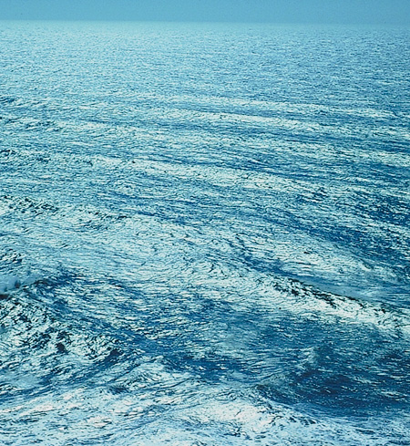
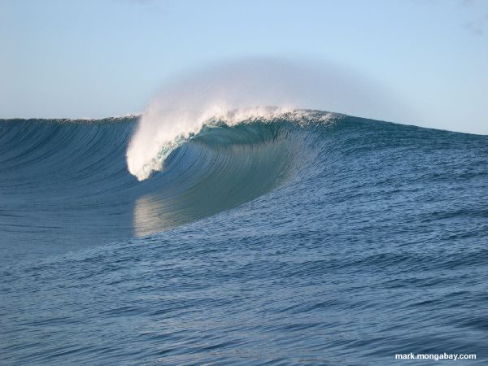
why do nonlinear fluid effects matter?
size of the “equilibrium” tide for a Jupiter-like planet
around a Sun-like star:
M
M’
δ
R
a
Over most of the star, the wave amplitude is
small, and the linear approximation to fluid
dynamics is good. But…
there can be small regions in stars where wave
amplitudes become large, and nonlinear
fluid processes become important.
Notes:
At first you might think that nonlinear effects are small, and can be ignored. This is indeed true for the “equilibrium tide”, or slight ellipsoidal deformation of the shape of the star
due to the tide raised by the planet. But, depending in detail on the star, certain regions can have much larger wave amplitudes. For nonrotating solar-type stars with mass M < 1.2 or so,
This occurs at mainly at the center.
Ocean waves linear and travel great distances in the ocean. But as they near shore, they steepen and break in a wave interaction zone tiny in compared to size of ocean.

Slide 7
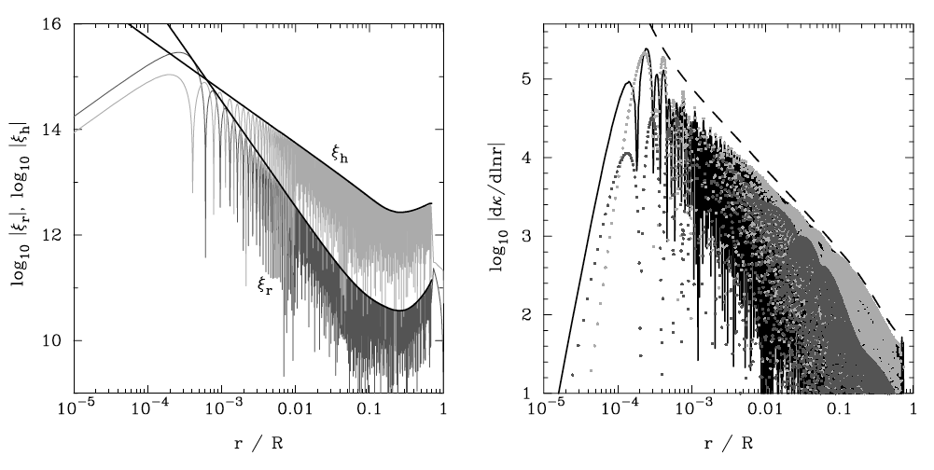
Steepening of g-modes near the center of solar-type stars
interaction
region

Slide 8
coupling the fluid to the orbit
Time evolution of the f, p, g modes:
damping
linear
tide
driving
nonlinear
tide
driving
3-wave
coupling
orbit forcing waves
internal
redistribution
waves force orbit
Time evolution of the orbit:
Notes:
Seismology: omega, gamma, overlap
Nonlinear interaction physics: nonlinear tide driving, kappa’s
Orbit forces waves. Waves have a quadrupole moment that forces orbit.

Slide 9
Linear theory for tidal Q
Solar model.
Radiative diffusion + turbulent viscosity.
resonant
“dynamical tide”
nonresonant
“equilibrium tide”
Decay time very long, but….
beware! This same theory under-predicts
rate for solar-type binaries.
mode frequency
Notes:
For linear response, you can factor out the overall strength of the tide, leaving a forcing-frequency dependent function to evaluate for 1/Q. You have to sum this up over every mode to get the total 1/Q.
Note that both the resonant and nonresonant contributions depend on forcing frequency!
Mention Penev and Sasselov

Slide 10
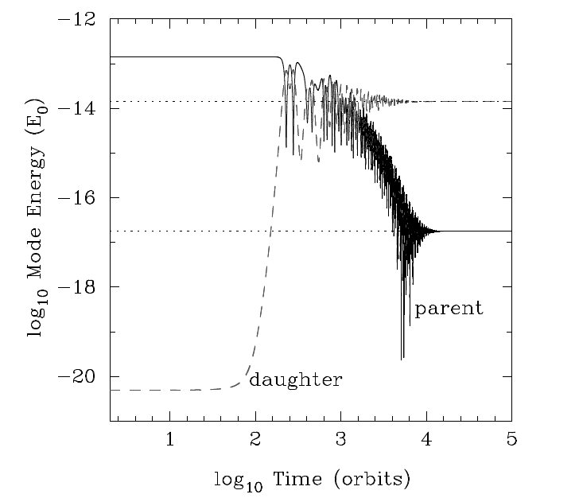
stability of the linear tide?
The linearly driven tide acts as a
time-dependent background on
which other waves propagate.
If this time-dependent background
resonates with two daughter waves,
then above a threshold amplitude
they can undergo the ``parametric
Instability” and grow exponentially,
eventually reachinga nonlinear
equilibrium.

Slide 11
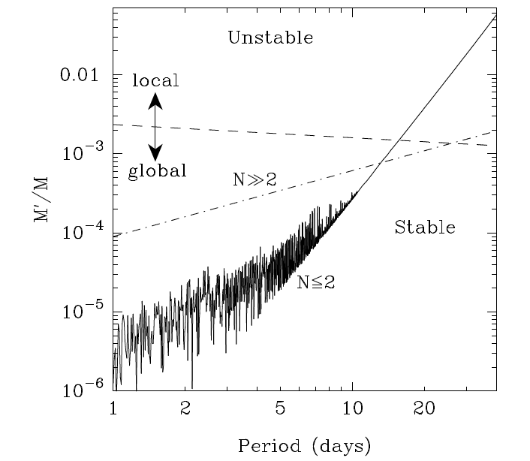
the linear tide is unstable, even for low mass companions
Jupiter
mass
Earth mass

Slide 12
amplitudes just above threshold
Analytic model for nonlinear
equilibrium amplitudes
of N>>1 parents and 1
daughter pair.
In phase
out of phase

Slide 13
orbital evolution rate just above threshold
Even for just one daughter pair, orbital evolution can be increased by a factor of 10 or more.
For Jupiter mass planets,
there can be thousands
of daughter pairs excited,
requiring numerical
simulations to understand the orbital evolution rate.
orbital evolution rate
threshold
Notes:
This is for epsilon=epscrit * ( 1.0 + 1.e-3 ). Or, about a 0.1Mjup planet.

Slide 14
Summary
Accurate theories of tidal dissipation are needed to
understand and make predictions for orbit/spin evolution.
The guilty pleasure of constant Q.
The linear tide gives very long orbital decay times, and frequency dependent Q’s.
The linear tide is unstable for a broad range of P_{orb} and planet
mass.
Just above threshold, there can be a ~X10 speedup in orbital evolution due to nonlinear dissipation from one daughter pair. Well above threshold numerical simulations of many modes may be necessary, and is under way.

Slide 15
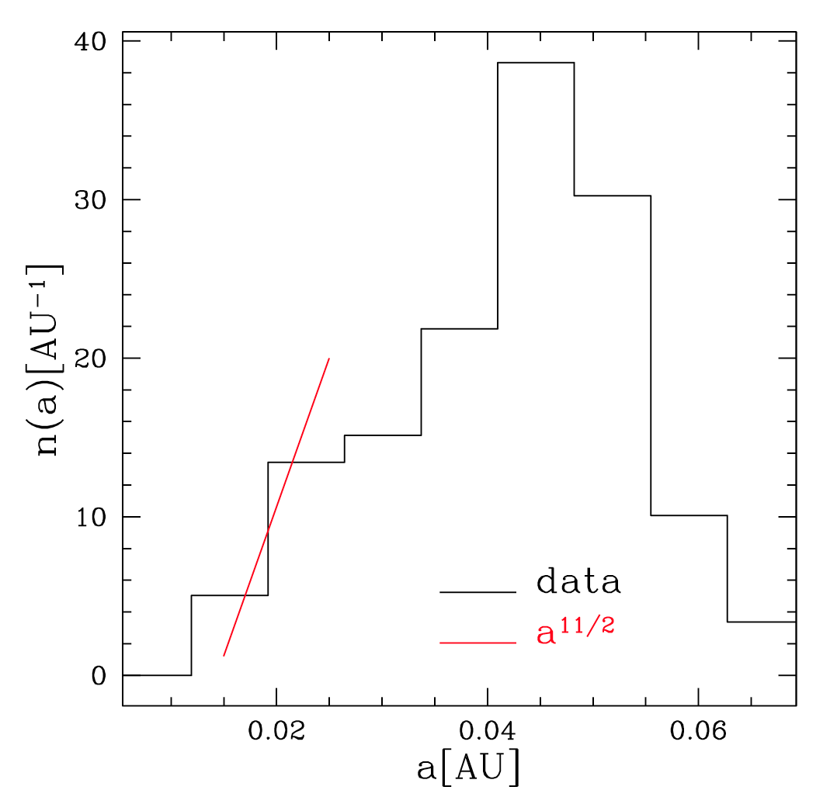
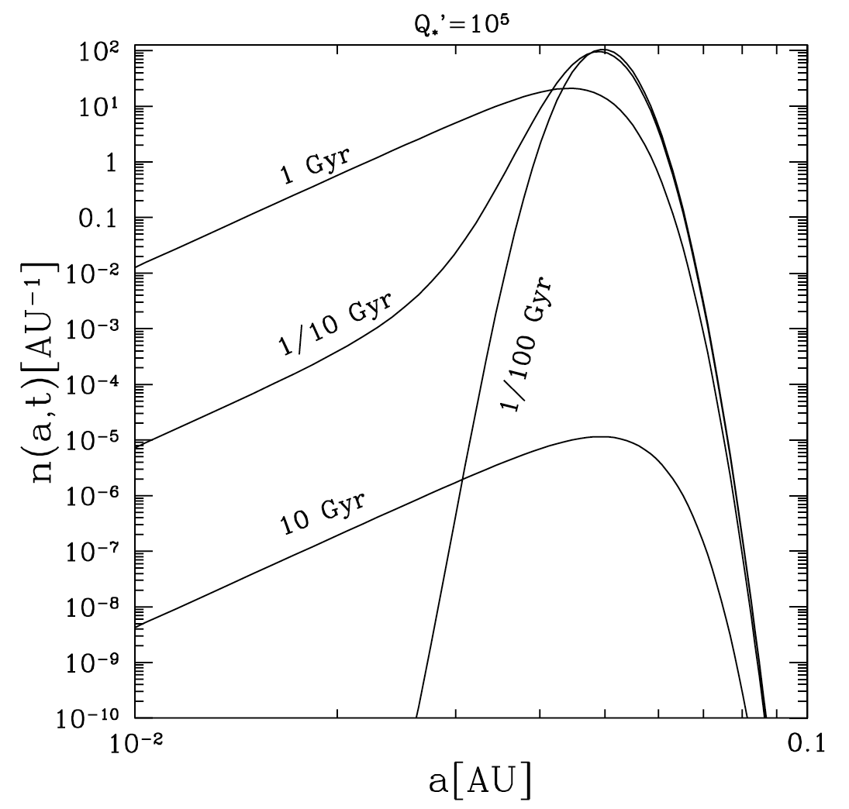
Orbital decay of a population of planets (In preparation.With Uva undergrads Meredith Nelson and Sarah Peacock)
When decay time << age,
observed distribution should
reflect the orbital decay law:
If decay times really short,
you should be able to measure the
frequency dependence of the tidal
Q from the observed distribution.

Slide 16
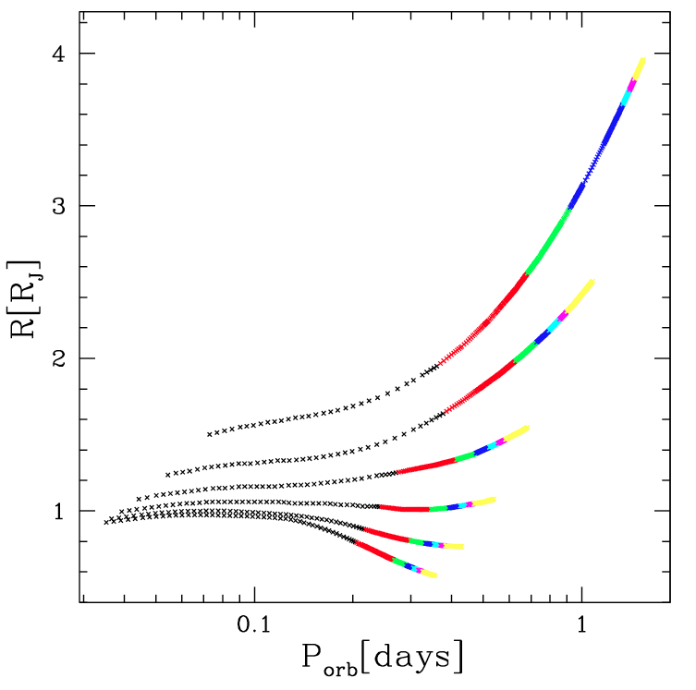
post-period-bounce remnant planets
(In preparation. With UVa undergrads Sarah Peacock and Meredith Nelson)
Orbital decay due to tides
Pushes planet into contact.
Radius subsequently evolves as
For conservative mass transfer,
the planet “period bounces”
and moves away from the
star as it loses mass.
Adiabatic evolution. Q_{star}=10⁵

Slide 17
Linear theory: stellar input data
G-modes can be resonant
with the tide, but have small
overlaps and weak damping.
f-modes: large overlap, weak damping, not resonant
p-modes: small overlap, large damping, not resonant
Notes:
F-mode is the global version of deep water waves we see in the ocean.

Slide 18
Convective cores
2.0
1.9
1.8
1.7
1.6
1.5
1.45
1.40
1.35
1.30
1.25
1.15
1.20
(Aerts et al, Asteroseismology)
Notes:
Aerts fig 3.6, pg 171. no core overshoot.

Slide 19
A simple model for nonlinear tidal dissipation: Press, Wiita & Smarr (1975)
Re >> 1 + instability gives turbulence.
For forcing frequency σ, saturation
with velocity and length scales
Turbulent viscosity
Yields an amplitude dependent tidal Q
Possible improvements:
Better tidal flow
waves not eddies
realistic dissipation
Identify instability
Q⁻¹
ε
Notes:
A simplified model for nonlinear tidal dissipation was presented a long time ago by Press et al.
Their model consists of the assumption of high reynolds number flow, and invokes some sort of instability
To initiate turbulence.
Once operating, turbulent eddies can transport momentum in the tidal flow much more effectively than ordinary molecular viscosity.
Given the basic velocity and length scales, and not worrying too much about the actual fluid motion or lengthscales in a real star, you can
Get the diffusion timescale due to turbulent viscosity over the star.
Since eddy velocity is proportional to amplitude, you get a amplitude dependent dissipation 1/Q.

