Slide 1
Magnetically Controlled Outflows from Hot Jupiters
Fred Adams, Univ. Michigan
Extreme Solar Systems II
Jackson, Wyoming, September 2011

Slide 2
Hot Jupiters can Evaporate
HD209458b (Vidal-Madjar et al. 2003, 2004; Desert et al. 2008; Sing et al. 2008; Lecavelier des Etangs et al. 2008)
HD189733b (Lecavelier des Etangs et al. 2010)

Slide 3
The Planetary System

Slide 4
Basic Regime of Operation

Slide 5
TWO COUPLED PROBLEMS
LAUNCH of the outflow from planet
PROPAGATION of the outflow in the joint environment of star and planet, including gravity, stellar wind, stellar magnetic field
Matched asymptotics: Outer limit of the inner problem (launch of wind) provides the inner boundary condition for the outer problem (propagation of wind)
This Work Focuses on Launch of the Wind

Slide 6
The Coordinate System

Slide 7
Magnetic Field Configuration
Magnetic field lines
are lines of constant
coordinate q.
The coordinate p
measures distance
along field lines.
Field lines are open
near planetary pole
and are closed near
the equator. Fraction
of open field lines:
OPEN FIELD LINES
CLOSED FIELD LINES

Slide 8
Equations of Motion
Steady-state flow along field-line direction:
Fluid fields are functions of coordinate p only.

Slide 9
Two parameters specify the dimensionless problem

Slide 10
Solutions
Sonic point
Continuity eq.
constant

Slide 11
Sonic Surface
OUTFLOW
DEAD ZONE

Slide 12
Fluid Field Solutions

Slide 13
Mass Outflow Rates

Slide 14
Mass Outflow Rates

Slide 15
Physical Outflow Rate vs Flux

Slide 16
Column Density

Slide 17
Observational Implications

Slide 18
The Extreme Regime
In systems where the stellar outflow
and the stellar magnetic field
are both sufficiently strong, the
Planet can Gain Mass from the Star

Slide 19
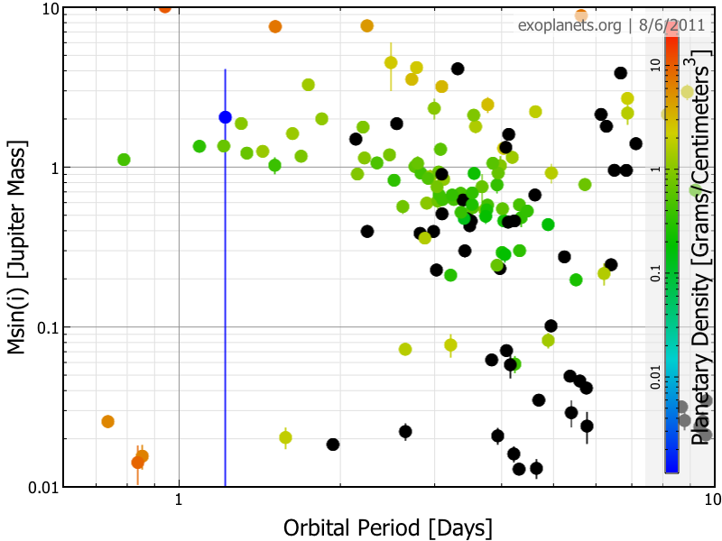
Implication/Prediction
The ZONE of EVAPORATION

Slide 20
Summary
Planetary outflows magnetically controlled
Outflow rates are moderately *lower*
Outflow geometry markedly different:
Open field lines from polar regions
Closed field lines from equatorial regions
In extreme regime with strong stellar outflow the planet could gain mass from the star
Outflow rates sensitive to planetary mass:
Reference: F. C. Adams, 2011, ApJ, 730, 27
see also: Trammell et al. (ApJ); Trammell Poster

Slide 21
